Slide 1
Systematic study of a corrugated waveguide as a microwave undulator
L. Zhang, W. He, J. Clarke, K. Ronald, A. D. R. Phelps, A. Cross and
Volume 26 | Part 1 | January 2019 | Pages 11–17 | 10.1107/S1600577518014297
Notes:
A microwave undulator operating at 36 GHz has been designed for a UK X-ray free-electron laser. The equivalent magnetic field is 1.27 T when driven by 50 MW of input power.

Slide 2
Systematic study of a corrugated waveguide as a microwave undulator
A microwave undulator operating at 36 GHz has been designed for a UK X-ray free-electron laser. The equivalent magnetic field is 1.27 T when driven by 50 MW of input power.
Keywords: microwave undulator; free-electron laser; corrugated waveguide; balanced hybrid condition
Zhang et al.
Volume 26 | Part 1 | January 2019 | Pages 11–17 | 10.1107/S1600577518014297
Notes:
Microwave undulators have great potential to be used in short-wavelength free-electron lasers. In this paper, the properties of a corrugated waveguide and its performance as an undulator cavity for a UK X-ray free-electron laser were systematically studied. The equations presented in this paper allow a fast estimation of the dimensions of the corrugated waveguide. An undulator cavity operating at 36 GHz designed for the HE11 and HE12 modes was investigated and the performance of both modes compared.

Slide 3
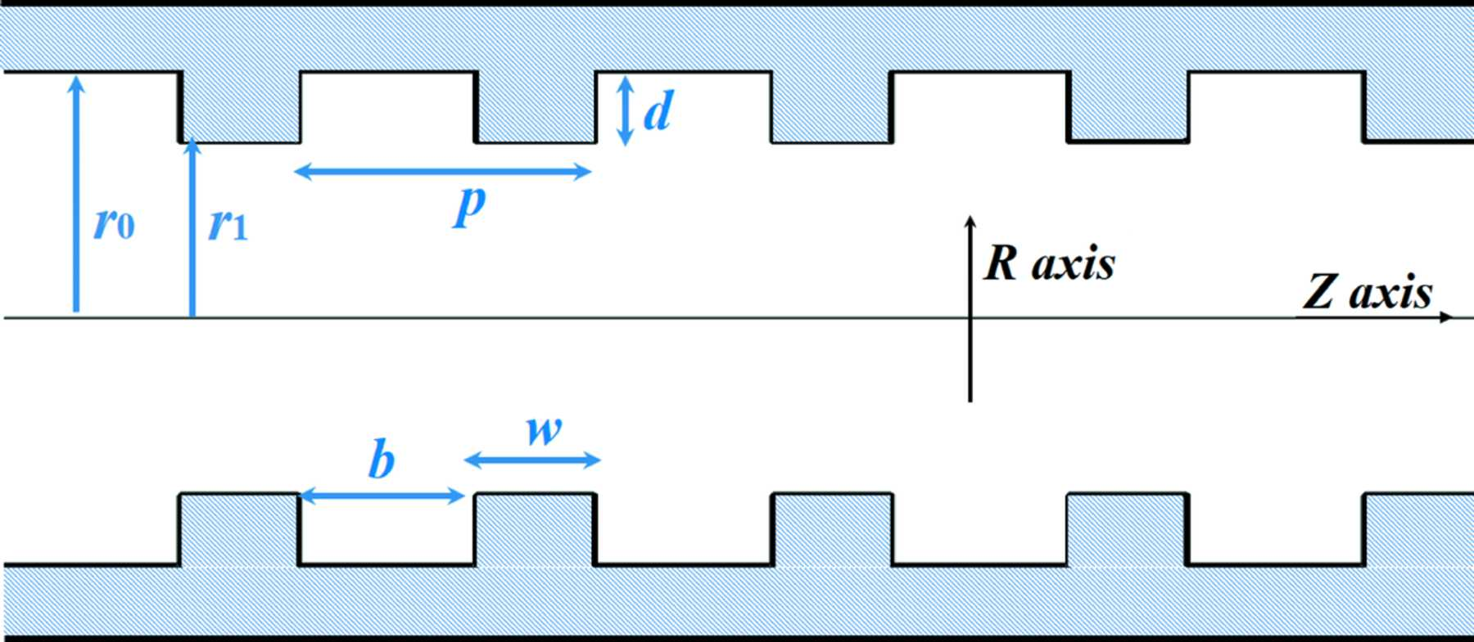
Figure 1. Schematic drawing of the corrugated waveguide.
Zhang et al.
Volume 26 | Part 1 | January 2019 | Pages 11–17 | 10.1107/S1600577518014297
Notes:
Schematic drawing of the corrugated waveguide. [Zhang, L., He, W., Clarke, J., Ronald, K., Phelps, A. D. R., Cross, A. and (2019). J. Synchrotron Rad. 26, 11-17. 10.1107/S1600577518014297]

Slide 4
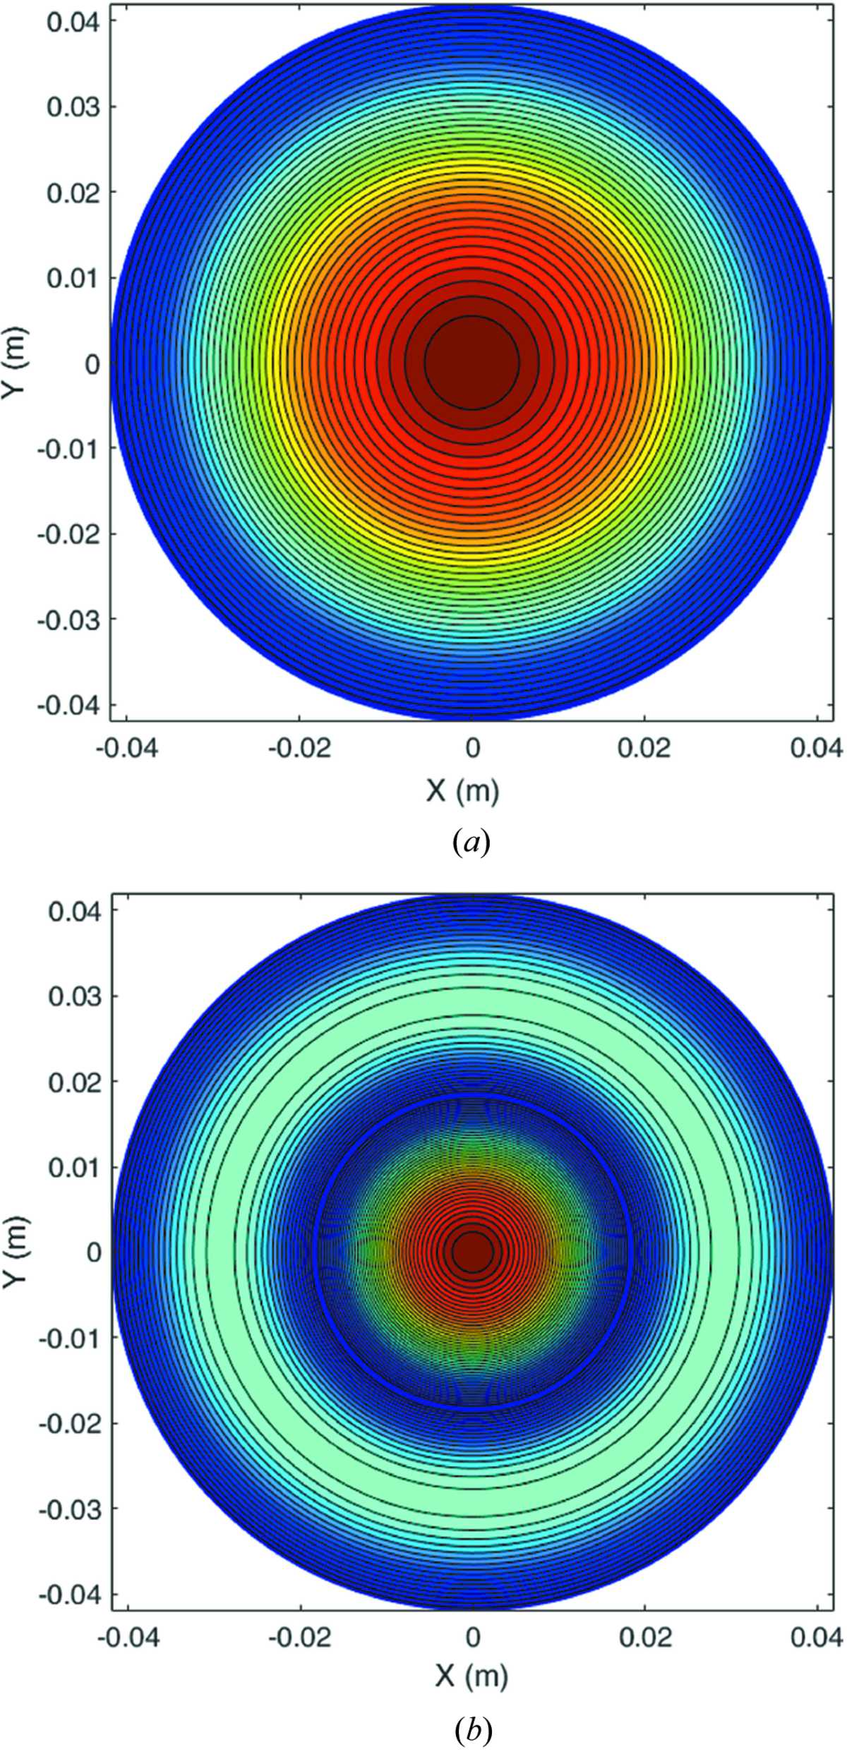
Figure 2. Contour plot of the electric field patterns of the (a) HE₁₁ and (b) HE₁₂ modes.
Zhang et al.
Volume 26 | Part 1 | January 2019 | Pages 11–17 | 10.1107/S1600577518014297
Notes:
Contour plot of the electric field patterns of the (a) HE11 and (b) HE12 modes. [Zhang, L., He, W., Clarke, J., Ronald, K., Phelps, A. D. R., Cross, A. and (2019). J. Synchrotron Rad. 26, 11-17. 10.1107/S1600577518014297]

Slide 5
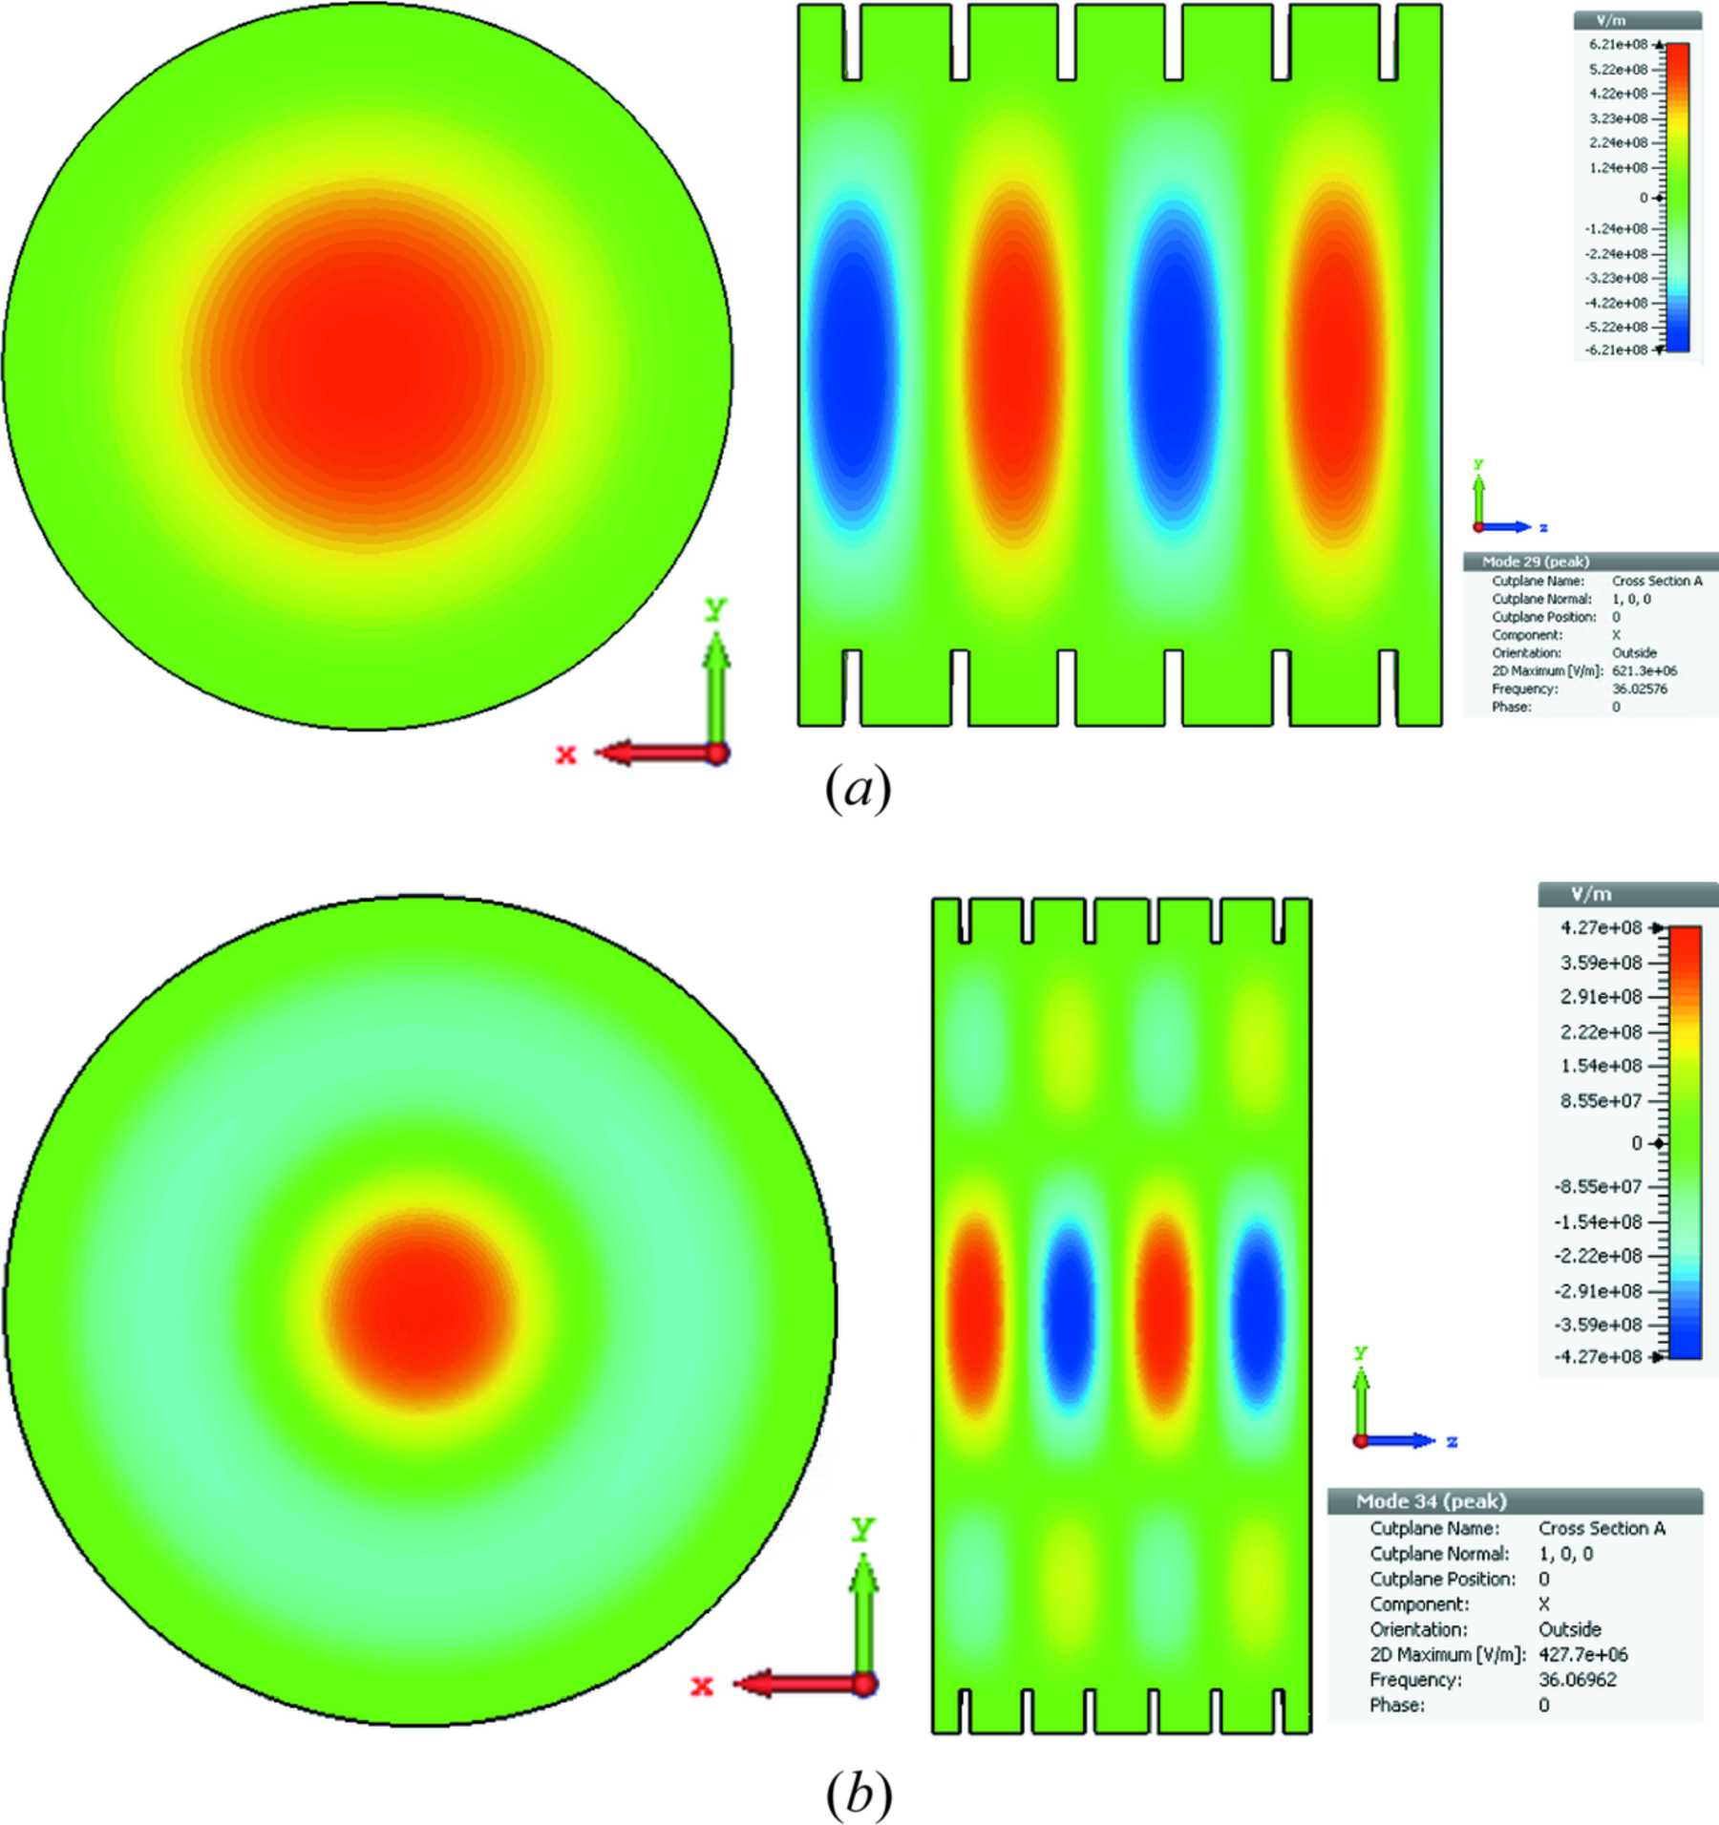
Figure 3. Electric field patterns of the (a) HE₁₁ and (b) HE₁₂ modes.
Zhang et al.
Volume 26 | Part 1 | January 2019 | Pages 11–17 | 10.1107/S1600577518014297
Notes:
Electric field patterns of the (a) HE11 and (b) HE12 modes. [Zhang, L., He, W., Clarke, J., Ronald, K., Phelps, A. D. R., Cross, A. and (2019). J. Synchrotron Rad. 26, 11-17. 10.1107/S1600577518014297]

Slide 6
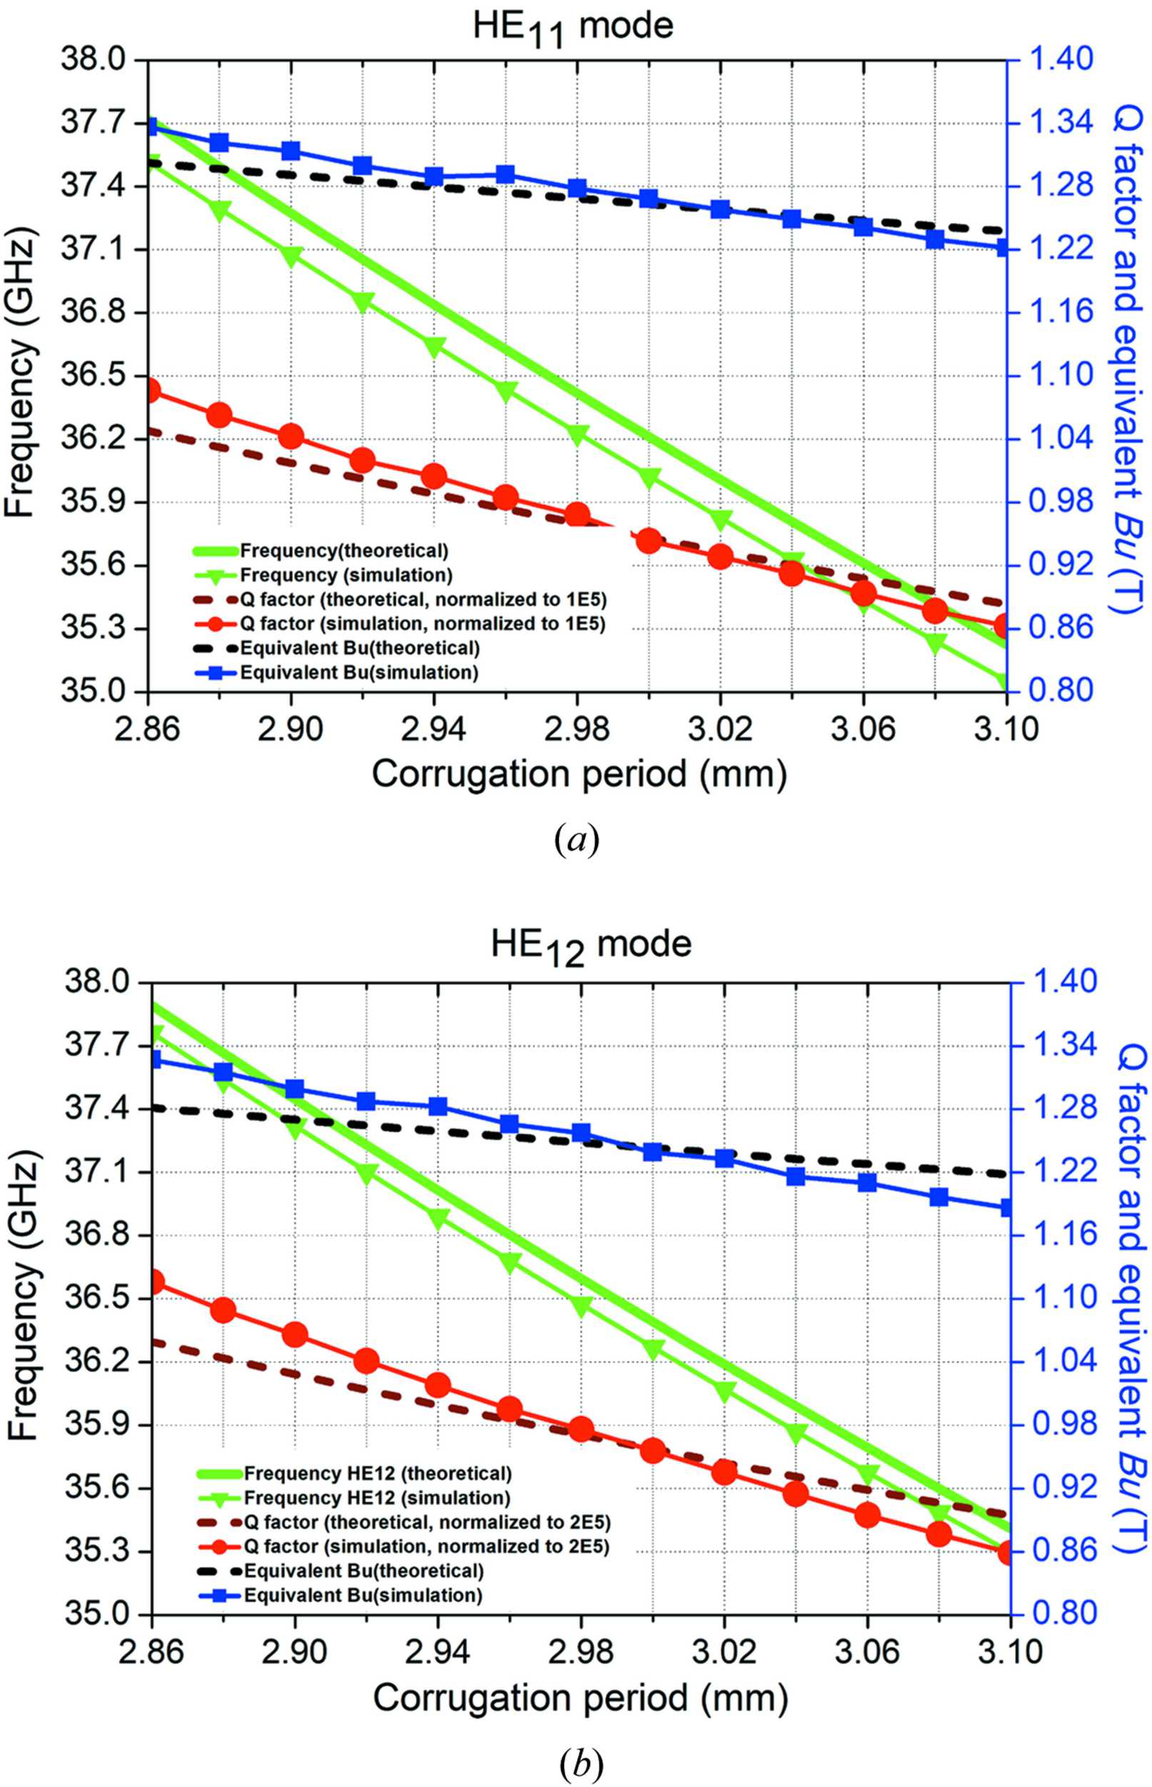
Figure 4. Simulation results of different corrugation periods: (a) HE₁₁ mode and (b) HE₁₂ mode.
Zhang et al.
Volume 26 | Part 1 | January 2019 | Pages 11–17 | 10.1107/S1600577518014297
Notes:
Simulation results of different corrugation periods: (a) HE11 mode and (b) HE12 mode. [Zhang, L., He, W., Clarke, J., Ronald, K., Phelps, A. D. R., Cross, A. and (2019). J. Synchrotron Rad. 26, 11-17. 10.1107/S1600577518014297]

Slide 7
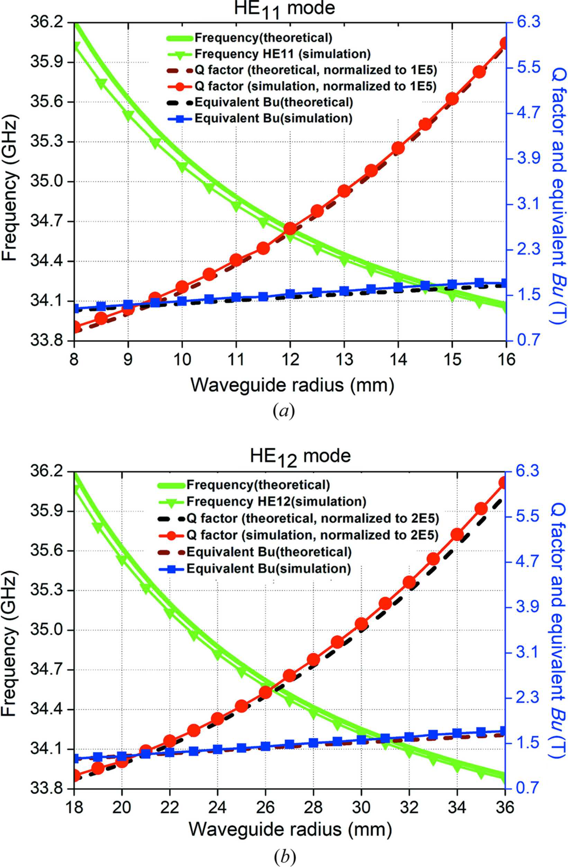
Figure 5. Simulation results of different waveguide radii: (a) HE₁₁ mode and (b) HE₁₂ mode.
Zhang et al.
Volume 26 | Part 1 | January 2019 | Pages 11–17 | 10.1107/S1600577518014297
Notes:
Simulation results of different waveguide radii: (a) HE11 mode and (b) HE12 mode. [Zhang, L., He, W., Clarke, J., Ronald, K., Phelps, A. D. R., Cross, A. and (2019). J. Synchrotron Rad. 26, 11-17. 10.1107/S1600577518014297]

Slide 8
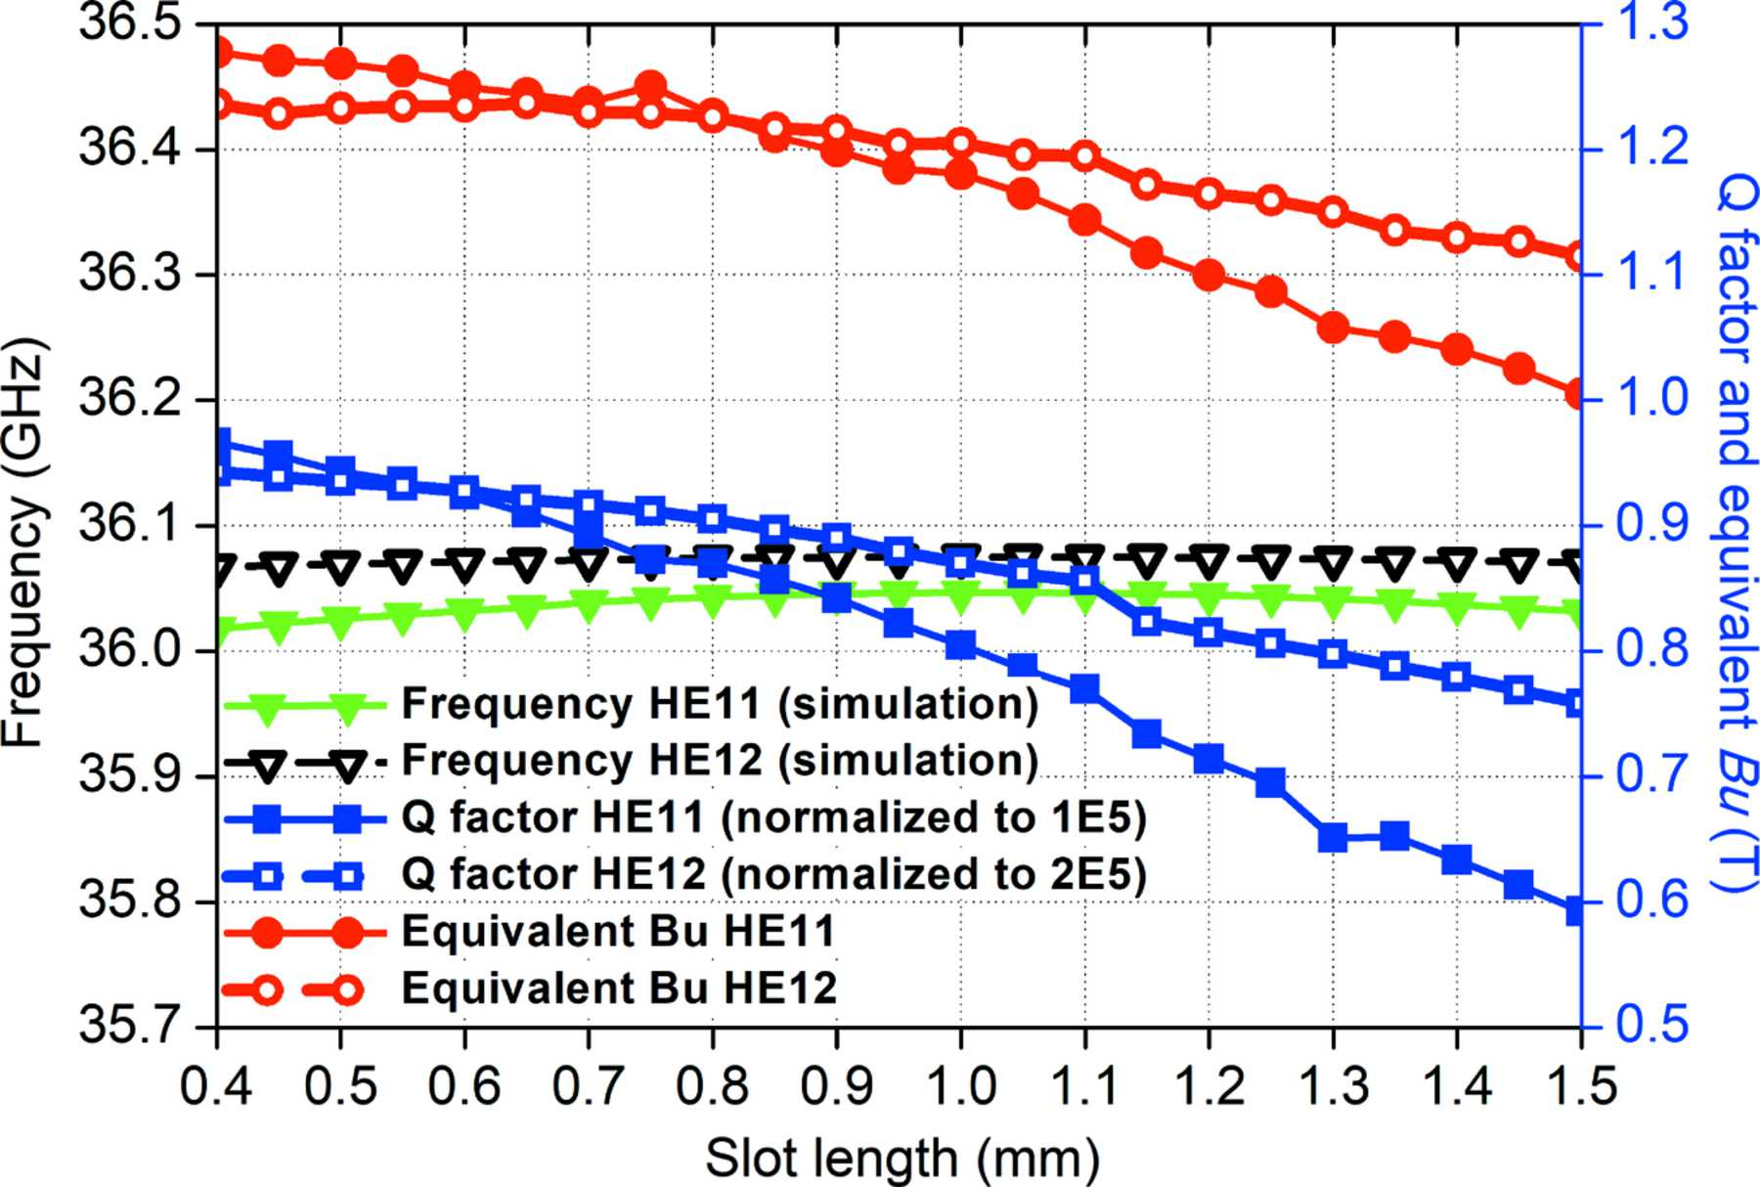
Figure 6. Simulation results of different slot lengths.
Zhang et al.
Volume 26 | Part 1 | January 2019 | Pages 11–17 | 10.1107/S1600577518014297
Notes:
Simulation results of different slot lengths. [Zhang, L., He, W., Clarke, J., Ronald, K., Phelps, A. D. R., Cross, A. and (2019). J. Synchrotron Rad. 26, 11-17. 10.1107/S1600577518014297]

