Slide 1
Crystal structure analysis of ebastine [4-(4-benzhydryloxy-1-piperidyl)-1-(4-tert-butylphenyl) butan-1-one]: an oral histamine antagonist
R. Sharma, D. Prasher and R. K. Tiwari
Volume 48 | Part 4 | August 2015 | Pages 1299–1301 | 10.1107/S160057671501050X
Notes:
The crystal and molecular structure of ebastine has been determined, employing the technique of single-crystal X-ray diffraction. The piperidine ring in the ebastine molecule was found to exist in a chair conformation.

Slide 2
Crystal structure analysis of ebastine [4-(4-benzhydryloxy-1-piperidyl)-1-(4-tert-butylphenyl) butan-1-one]: an oral histamine antagonist
The crystal and molecular structure of ebastine has been determined, employing the technique of single-crystal X-ray diffraction. The piperidine ring in the ebastine molecule was found to exist in a chair conformation.
Keywords: ebastine; allergic diseases; crystal structure; X-ray diffraction
Sharma et al.
Volume 48 | Part 4 | August 2015 | Pages 1299–1301 | 10.1107/S160057671501050X
Notes:
Ebastine belongs to the category of second-generation non-sedating H1 receptor antagonists and is chiefly used for the treatment of allergic rhinitis and chronic urticaria. The present paper reports findings on the crystal and molecular structure of ebastine, employing the technique of single-crystal X-ray diffraction. Ebastine crystallizes in the monoclinic P21/c space group with unit-cell dimensions a = 16.5890 (12), b = 10.9575 (8), c = 16.6795 (11) Å, β = 113.623 (2)°, V = 2777.8 (3) Å3, Z = 4 and calculated density amounting to 1.123 Mg m−3. The structure factor value was observed 1016 and final R = 0.0496 for 4360 unique reflections. The piperidine ring in the ebastine molecule was found to exist in a chair conformation, and the C—N bond length was 1.459 (3) Å, thereby showing good agreement with the standard C—N bond length of 1.472 Å.

Slide 3
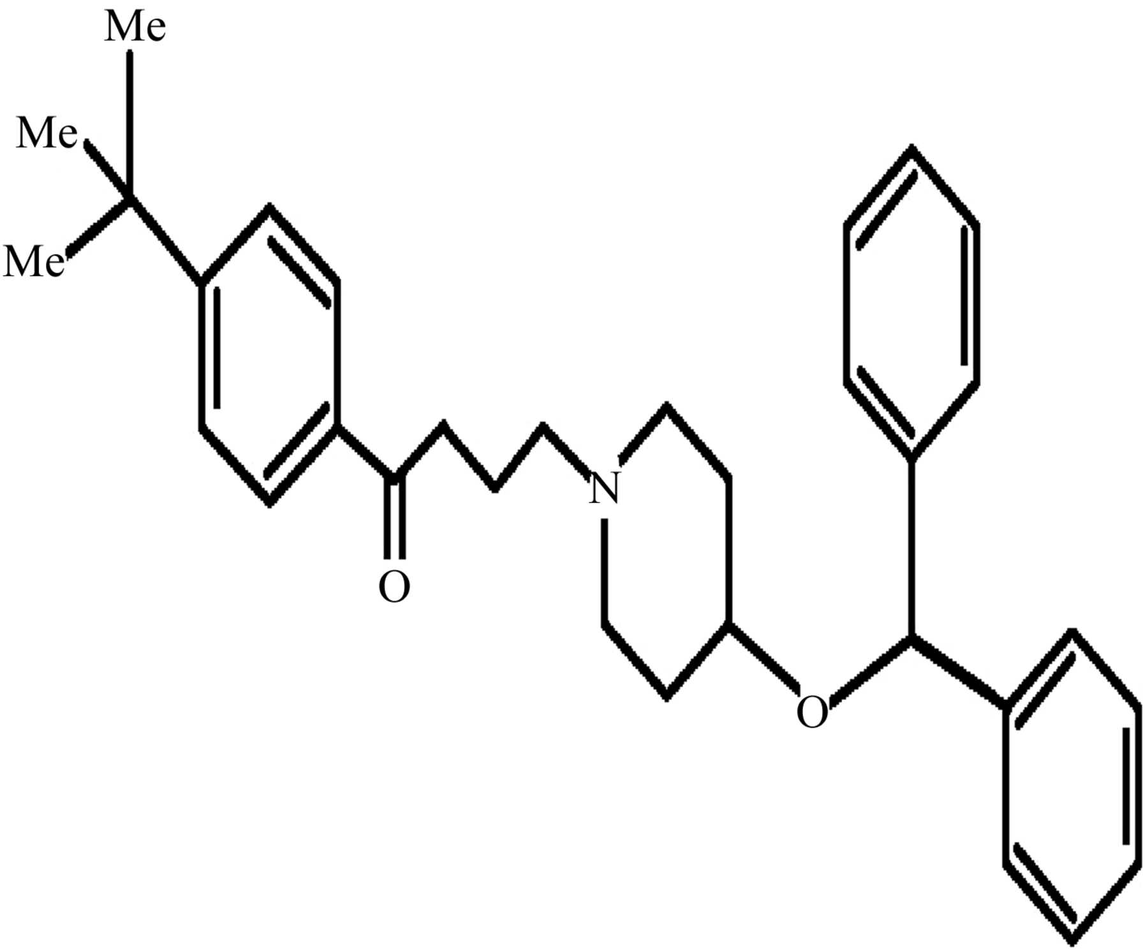
Figure 1. Chemical structure of ebastine.
Sharma et al.
Volume 48 | Part 4 | August 2015 | Pages 1299–1301 | 10.1107/S160057671501050X
Notes:
Chemical structure of ebastine. [Sharma, R., Prasher, D. and Tiwari, R. K. (2015). J. Appl. Cryst. 48, 1299-1301. 10.1107/S160057671501050X]

Slide 4
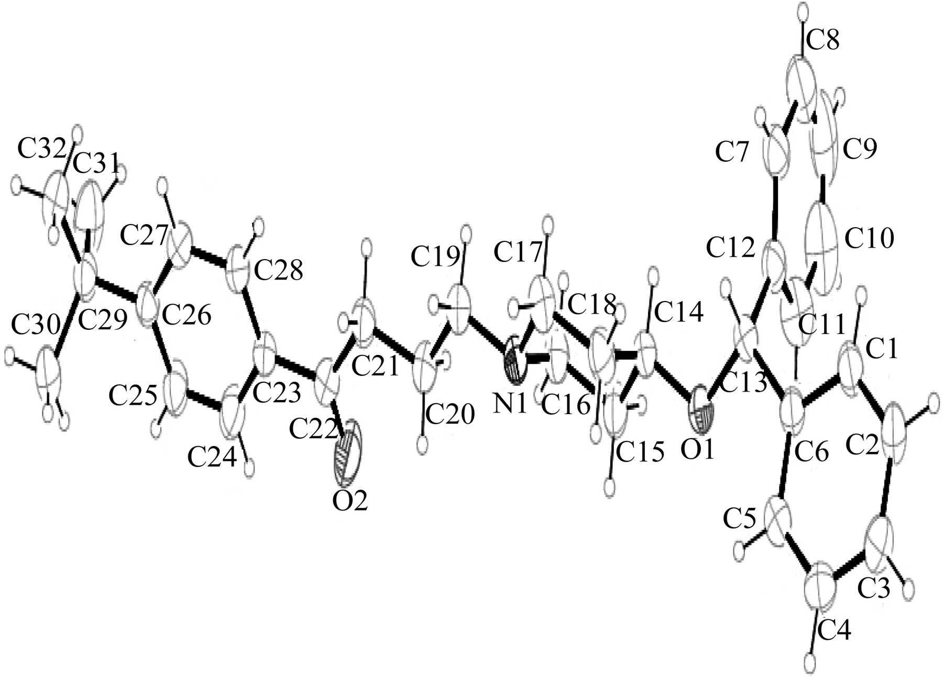
Figure 2. An ORTEP view of the title compound, showing the molecular configuration and its atomic numbering scheme. Displacement ellipsoids are drawn at the 50% probability level. H atoms are drawn ...
Sharma et al.
Volume 48 | Part 4 | August 2015 | Pages 1299–1301 | 10.1107/S160057671501050X
Notes:
An ORTEP view of the title compound, showing the molecular configuration and its atomic numbering scheme. Displacement ellipsoids are drawn at the 50% probability level. H atoms are drawn as circles of arbitrary radius. [Sharma, R., Prasher, D. and Tiwari, R. K. (2015). J. Appl. Cryst. 48, 1299-1301. 10.1107/S160057671501050X]

Slide 5
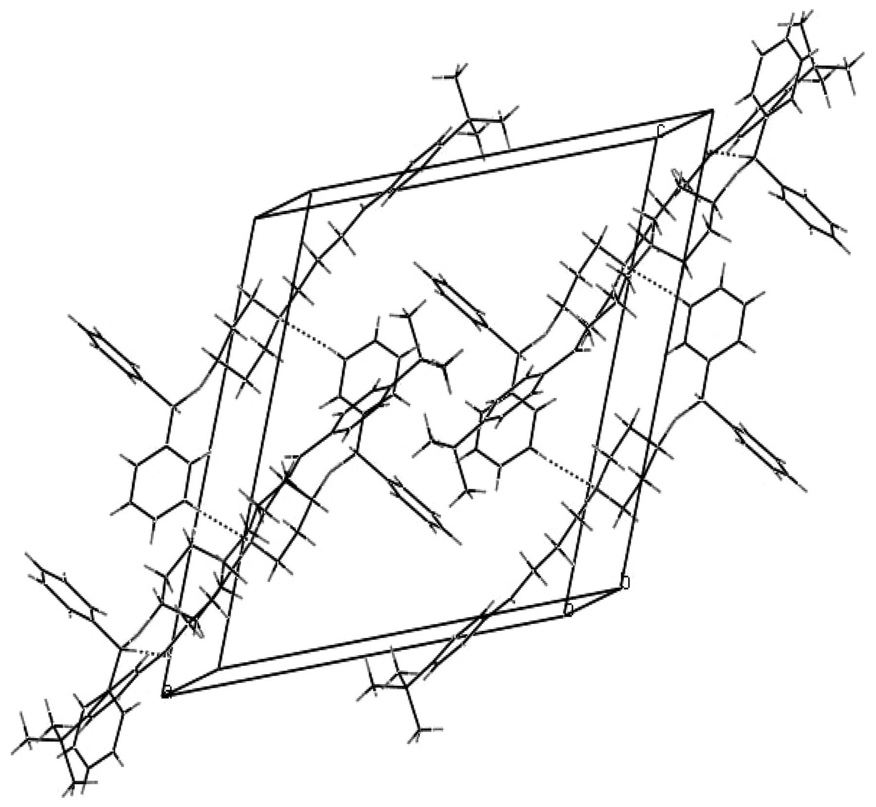
Figure 3. The crystal packing structure of ebastine along the b axis. Hydrogen bonds are shown as dashed lines. H atoms have been omitted for clarity.
Sharma et al.
Volume 48 | Part 4 | August 2015 | Pages 1299–1301 | 10.1107/S160057671501050X
Notes:
The crystal packing structure of ebastine along the b axis. Hydrogen bonds are shown as dashed lines. H atoms have been omitted for clarity. [Sharma, R., Prasher, D. and Tiwari, R. K. (2015). J. Appl. Cryst. 48, 1299-1301. 10.1107/S160057671501050X]

