Slide 1
DLSR: a solution to the parallax artefact in X-ray diffraction computed tomography data
A. Vamvakeros, A. A. Coelho, D. Matras, H. Dong, Y. Odarchenko, S. W. T. Price, K. T. Butler, O. Gutowski, A.-C. Dippel, M. Zimmermann, I. Martens, J. Drnec, A. M. Beale, S. D. M. Jacques and
Volume 53 | Part 6 | December 2020 | Pages 1531–1541 | 10.1107/S1600576720013576
Notes:
A new reconstruction approach is presented that can directly yield physico-chemical images and overcome the parallax problem in X-ray diffraction computed tomography experiments.

Slide 2
DLSR: a solution to the parallax artefact in X-ray diffraction computed tomography data
A new reconstruction approach is presented that can directly yield physico-chemical images and overcome the parallax problem in X-ray diffraction computed tomography experiments.
Keywords: X-ray scattering; tomography; X-ray diffraction; XRD; wide-angle X-ray scattering; WAXS
Vamvakeros et al.
Volume 53 | Part 6 | December 2020 | Pages 1531–1541 | 10.1107/S1600576720013576
Notes:
A new tomographic reconstruction algorithm is presented, termed direct least-squares reconstruction (DLSR), which solves the well known parallax problem in X-ray-scattering-based experiments. The parallax artefact arises from relatively large samples where X-rays, scattered from a scattering angle 2θ, arrive at multiple detector elements. This phenomenon leads to loss of physico-chemical information associated with diffraction peak shape and position (i.e. altering the calculated crystallite size and lattice parameter values, respectively) and is currently the major barrier to investigating samples and devices at the centimetre level (scale-up problem). The accuracy of the DLSR algorithm has been tested against simulated and experimental X-ray diffraction computed tomography data using the TOPAS software.

Slide 3
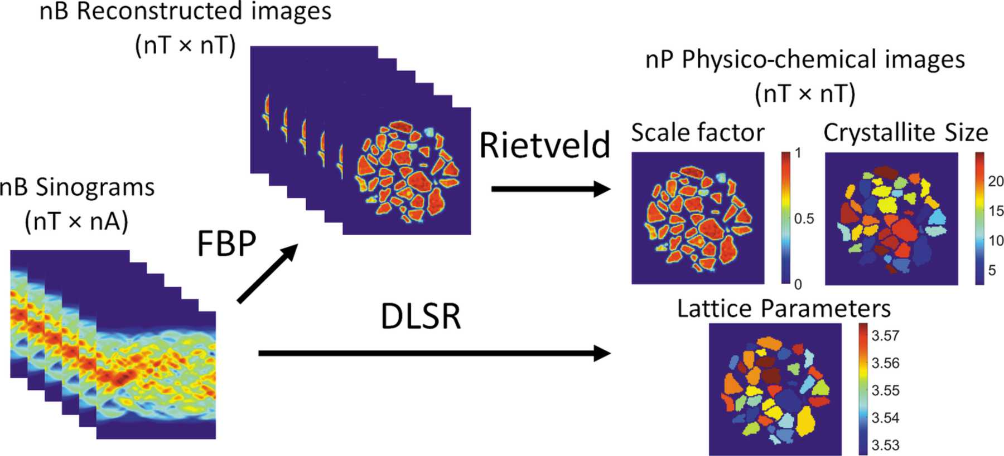
Figure 1. Schematic representation of the conventional data analysis route used in XRD-CT (top row) and the DLSR approach (bottom row) which yields physico-chemical images in a single step.
Vamvakeros et al.
Volume 53 | Part 6 | December 2020 | Pages 1531–1541 | 10.1107/S1600576720013576
Notes:
Schematic representation of the conventional data analysis route used in XRD-CT (top row) and the DLSR approach (bottom row) which yields physico-chemical images in a single step. [Vamvakeros, A., Coelho, A. A., Matras, D., Dong, H., Odarchenko, Y., Price, S. W. T., Butler, K. T., Gutowski, O., Dippel, A.-C., Zimmermann, M., Martens, I., Drnec, J., Beale, A. M., Jacques, S. D. M. and (2020). J. Appl. Cryst. 53, 1531-1541. 10.1107/S1600576720013576]

Slide 4
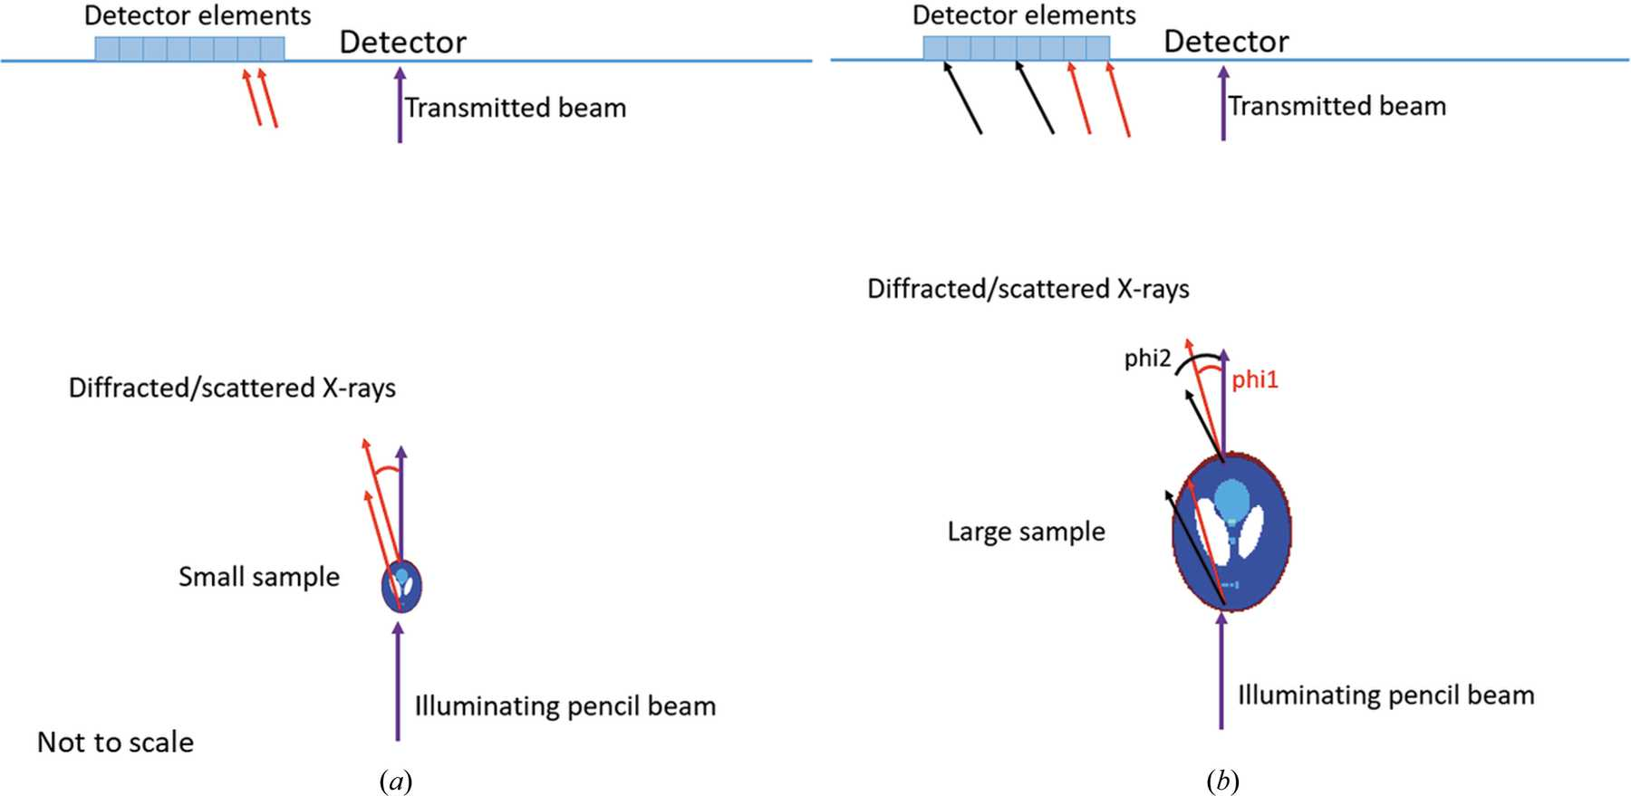
Figure 2. (a) Schematic representation of an XRD pattern collected in transmission geometry with an area detector when there is no parallax artefact. The scattered X-rays at a given 2θ angle ...
Vamvakeros et al.
Volume 53 | Part 6 | December 2020 | Pages 1531–1541 | 10.1107/S1600576720013576
Notes:
(a) Schematic representation of an XRD pattern collected in transmission geometry with an area detector when there is no parallax artefact. The scattered X-rays at a given 2θ angle along the sample arrive at the same detector element. (b) Illustration of a diffraction measurement in transmission geometry with parallax artefact. The X-rays scattered/diffracted along the sample at certain 2θ angles arrive at different detector elements, leading to peak broadening and even peak splitting. [Vamvakeros, A., Coelho, A. A., Matras, D., Dong, H., Odarchenko, Y., Price, S. W. T., Butler, K. T., Gutowski, O., Dippel, A.-C., Zimmermann, M., Martens, I., Drnec, J., Beale, A. M., Jacques, S. D. M. and (2020). J. Appl. Cryst. 53, 1531-1541. 10.1107/S1600576720013576]

Slide 5
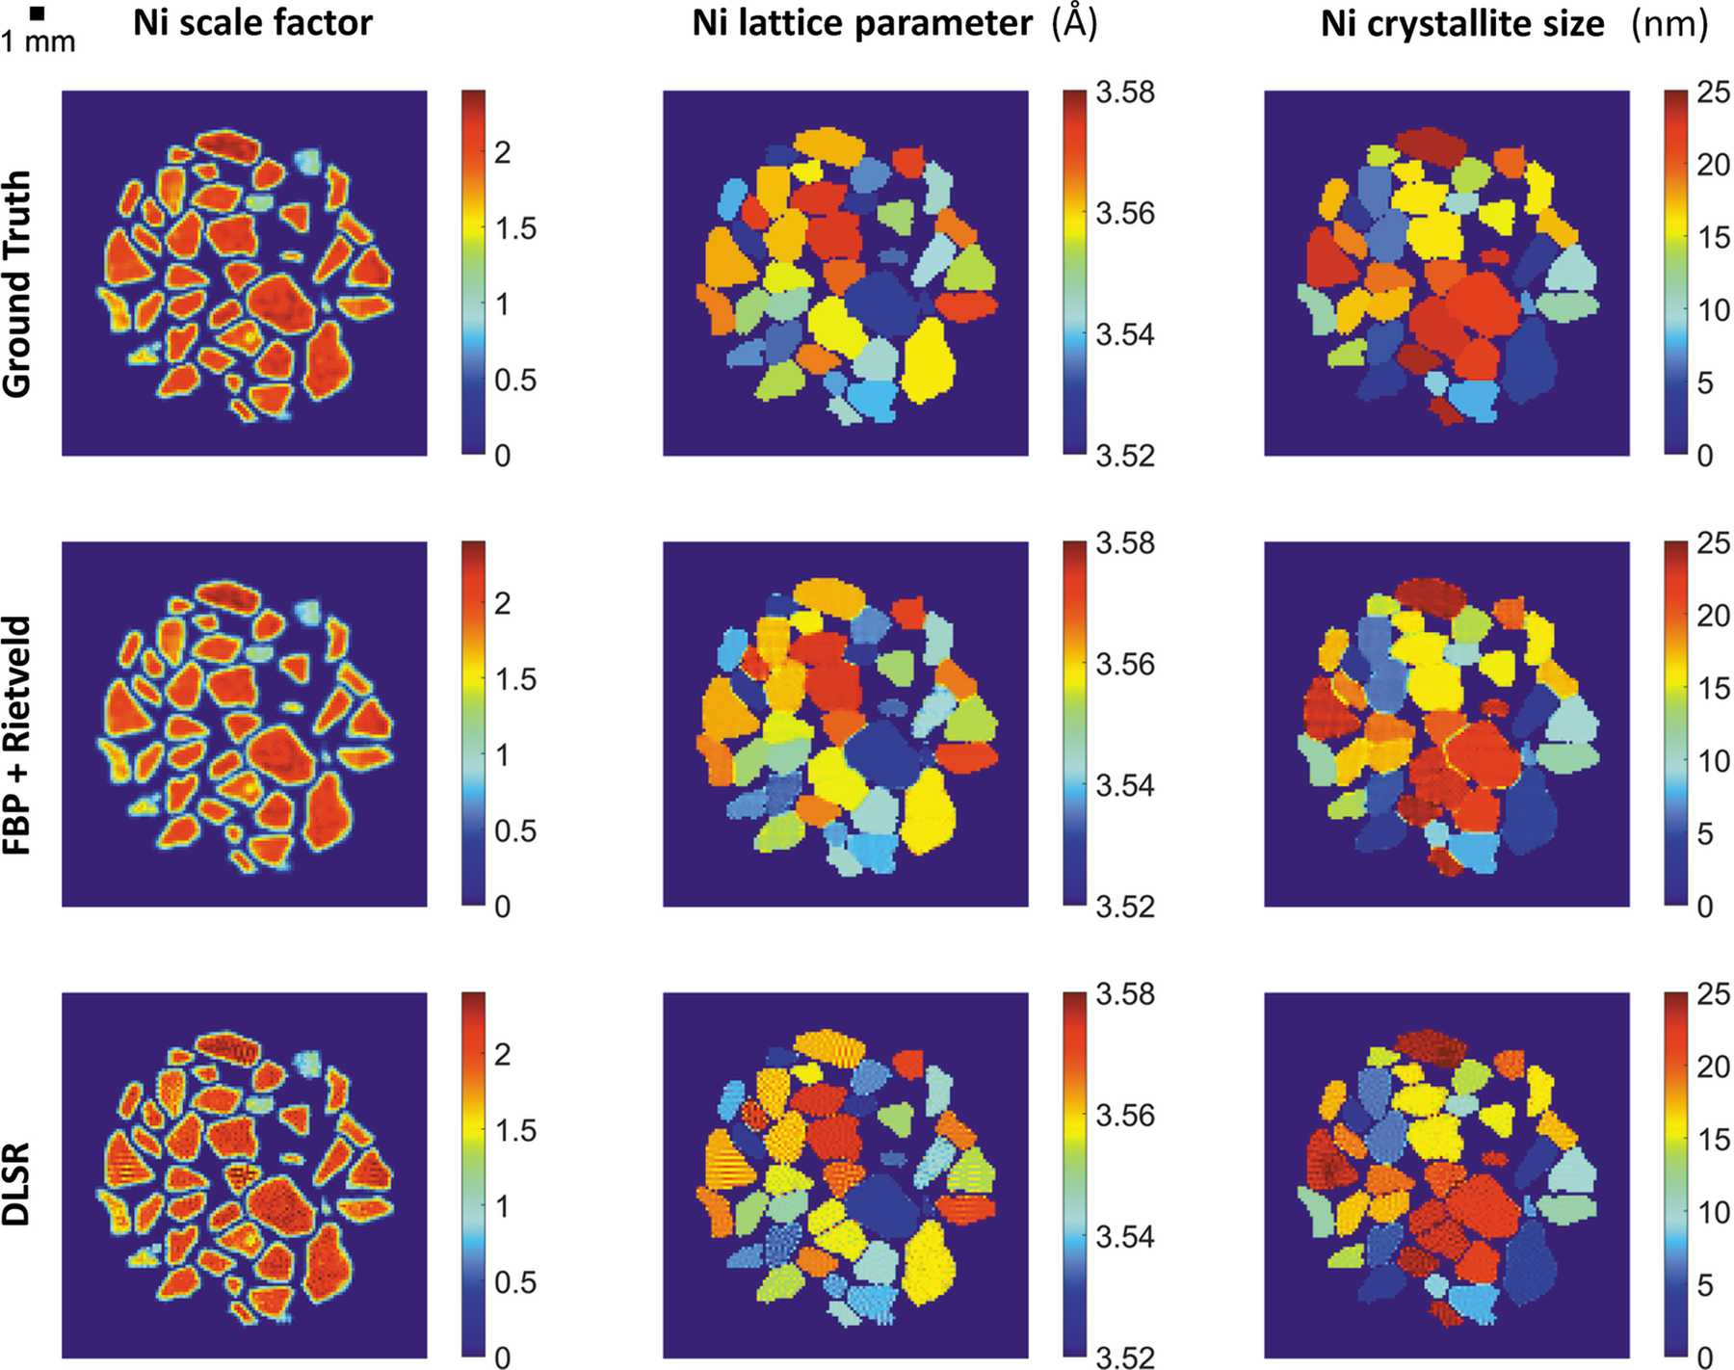
Figure 3. Parallax-free XRD-CT simulations. Top row: the ground truth images from the simulated Ni XRD-CT data. Middle row: results obtained from the sequential Rietveld analysis of the reconstructed XRD ...
Vamvakeros et al.
Volume 53 | Part 6 | December 2020 | Pages 1531–1541 | 10.1107/S1600576720013576
Notes:
Parallax-free XRD-CT simulations. Top row: the ground truth images from the simulated Ni XRD-CT data. Middle row: results obtained from the sequential Rietveld analysis of the reconstructed XRD-CT data. Bottom row: images derived from the Rietveld reconstruction of the XRD-CT data using the DLSR approach. [Vamvakeros, A., Coelho, A. A., Matras, D., Dong, H., Odarchenko, Y., Price, S. W. T., Butler, K. T., Gutowski, O., Dippel, A.-C., Zimmermann, M., Martens, I., Drnec, J., Beale, A. M., Jacques, S. D. M. and (2020). J. Appl. Cryst. 53, 1531-1541. 10.1107/S1600576720013576]

Slide 6
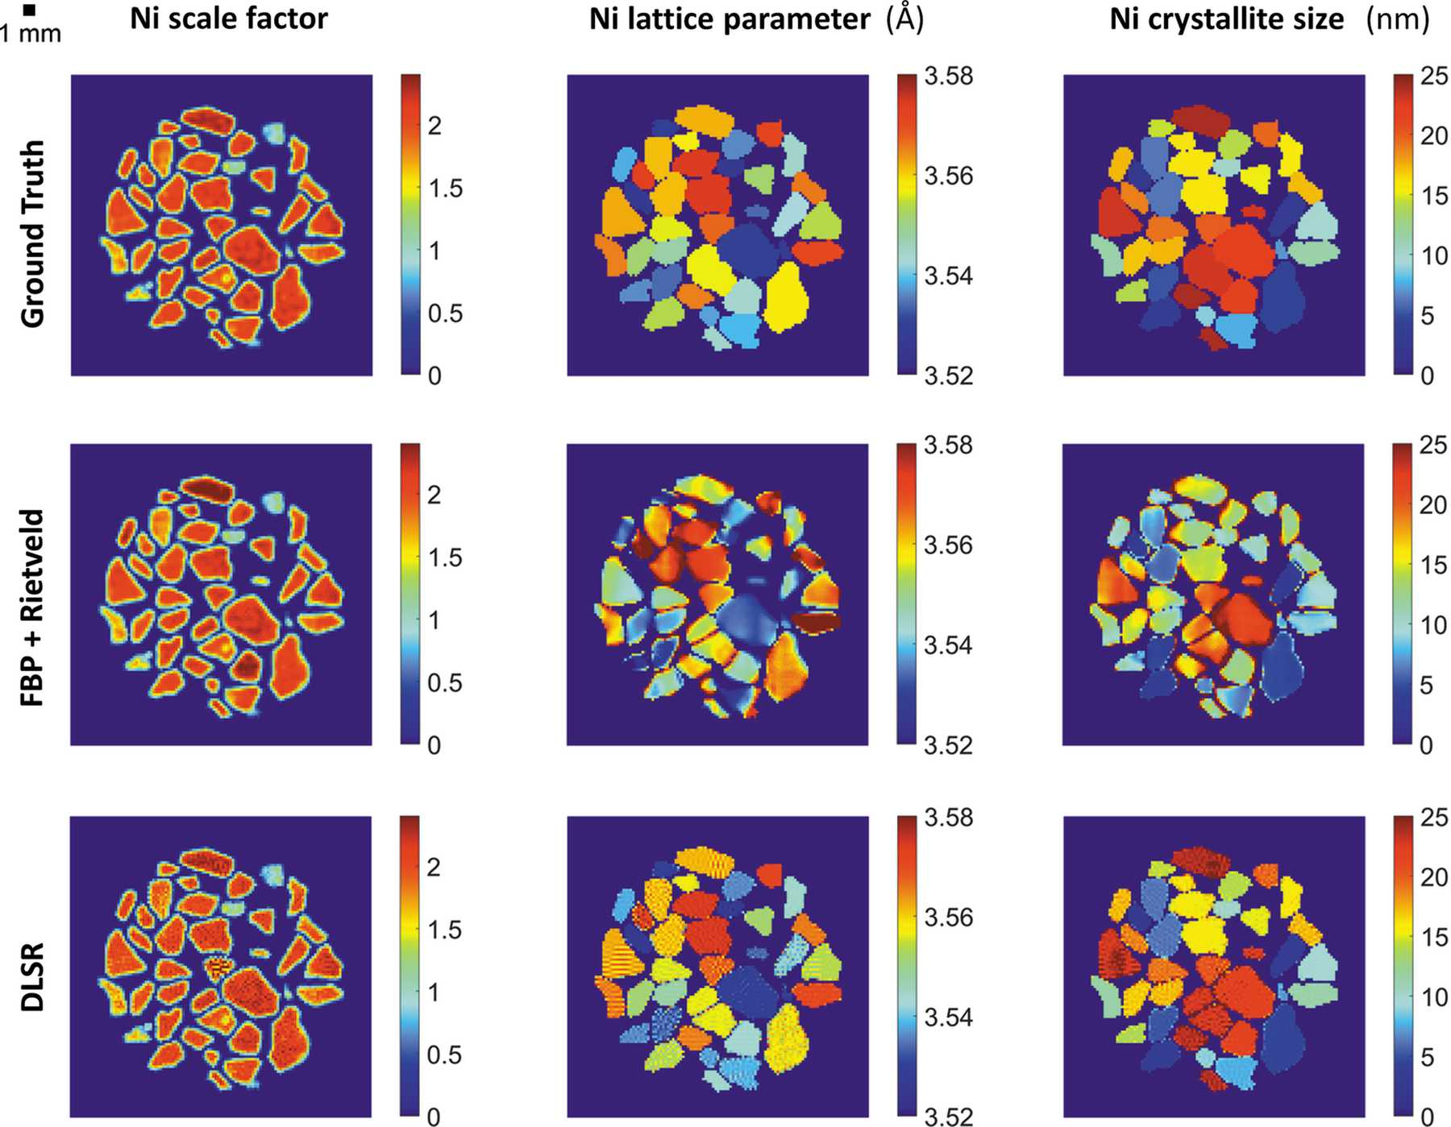
Figure 4. Parallax XRD-CT simulations. Top row: the ground truth images from the simulated Ni XRD-CT data. Middle row: results obtained from the sequential Rietveld analysis of the reconstructed XRD-CT ...
Vamvakeros et al.
Volume 53 | Part 6 | December 2020 | Pages 1531–1541 | 10.1107/S1600576720013576
Notes:
Parallax XRD-CT simulations. Top row: the ground truth images from the simulated Ni XRD-CT data. Middle row: results obtained from the sequential Rietveld analysis of the reconstructed XRD-CT data containing parallax artefacts. Bottom row: images derived from the Rietveld reconstruction of the XRD-CT data containing parallax artefacts using the DLSR approach. [Vamvakeros, A., Coelho, A. A., Matras, D., Dong, H., Odarchenko, Y., Price, S. W. T., Butler, K. T., Gutowski, O., Dippel, A.-C., Zimmermann, M., Martens, I., Drnec, J., Beale, A. M., Jacques, S. D. M. and (2020). J. Appl. Cryst. 53, 1531-1541. 10.1107/S1600576720013576]

Slide 7
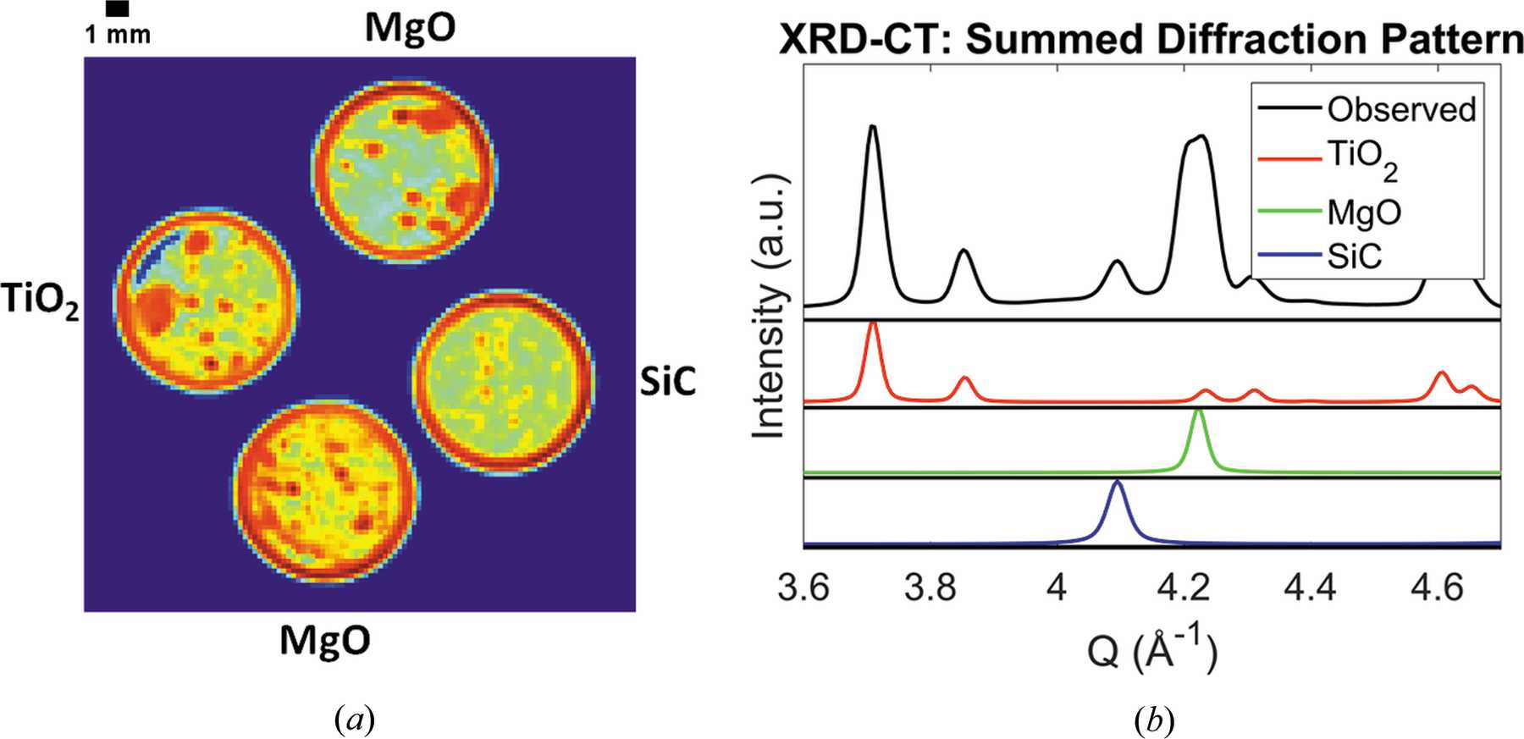
Figure 5. Left: normalized summed XRD-CT image showing the four samples (TiO₂, SiC and 2 × MgO) in their sample holders. Right: magnified region of the XRD-CT summed diffraction pattern showing ...
Vamvakeros et al.
Volume 53 | Part 6 | December 2020 | Pages 1531–1541 | 10.1107/S1600576720013576
Notes:
Left: normalized summed XRD-CT image showing the four samples (TiO2, SiC and 2 × MgO) in their sample holders. Right: magnified region of the XRD-CT summed diffraction pattern showing the splitting of an MgO diffraction peak. [Vamvakeros, A., Coelho, A. A., Matras, D., Dong, H., Odarchenko, Y., Price, S. W. T., Butler, K. T., Gutowski, O., Dippel, A.-C., Zimmermann, M., Martens, I., Drnec, J., Beale, A. M., Jacques, S. D. M. and (2020). J. Appl. Cryst. 53, 1531-1541. 10.1107/S1600576720013576]

Slide 8
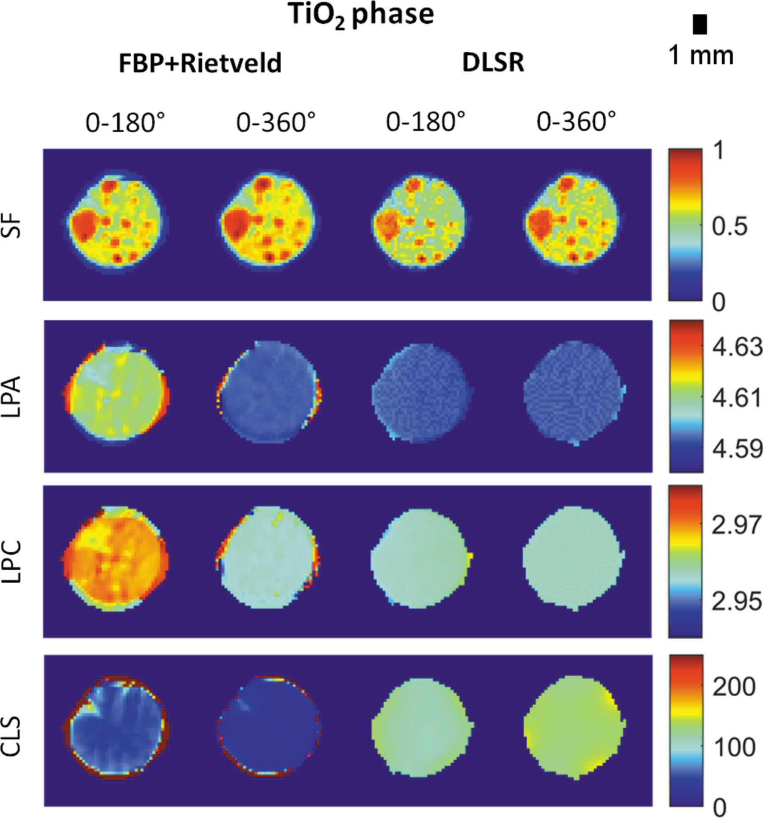
Figure 6. Top row: TiO₂ normalized scale factor (SF) maps. Second row: TiO₂ lattice parameter a (LPA) maps (colour-bar axis in Å). Third row: TiO₂ lattice parameter c ...
Vamvakeros et al.
Volume 53 | Part 6 | December 2020 | Pages 1531–1541 | 10.1107/S1600576720013576
Notes:
Top row: TiO2 normalized scale factor (SF) maps. Second row: TiO2 lattice parameter a (LPA) maps (colour-bar axis in Å). Third row: TiO2 lattice parameter c (LPC) maps (colour-bar axis in Å). Bottom row: TiO2 crystallite (CLS) maps (colour-bar axis in nm). [Vamvakeros, A., Coelho, A. A., Matras, D., Dong, H., Odarchenko, Y., Price, S. W. T., Butler, K. T., Gutowski, O., Dippel, A.-C., Zimmermann, M., Martens, I., Drnec, J., Beale, A. M., Jacques, S. D. M. and (2020). J. Appl. Cryst. 53, 1531-1541. 10.1107/S1600576720013576]

Slide 9
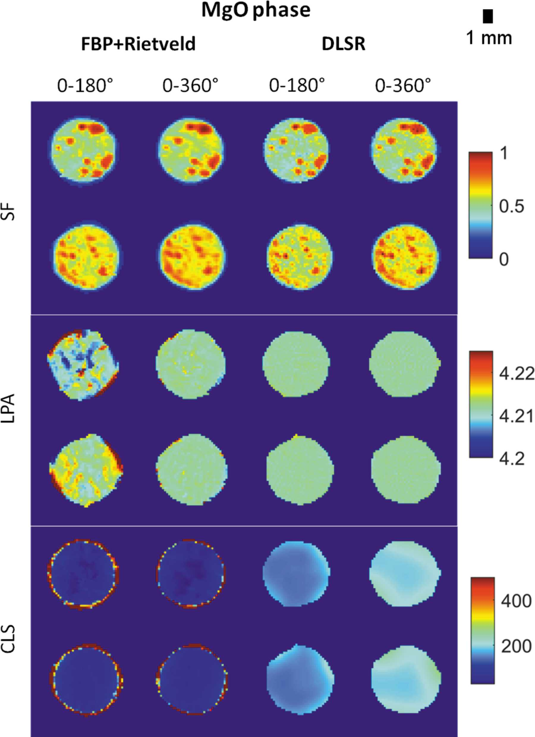
Figure 7. Top two rows: MgO normalized scale factor (SF) maps. Middle two rows: MgO lattice parameter a (LPA) maps (colour-bar axis in Å). Bottom two rows: MgO crystallite (CLS) maps (colour ...
Vamvakeros et al.
Volume 53 | Part 6 | December 2020 | Pages 1531–1541 | 10.1107/S1600576720013576
Notes:
Top two rows: MgO normalized scale factor (SF) maps. Middle two rows: MgO lattice parameter a (LPA) maps (colour-bar axis in Å). Bottom two rows: MgO crystallite (CLS) maps (colour-bar axis in nm). [Vamvakeros, A., Coelho, A. A., Matras, D., Dong, H., Odarchenko, Y., Price, S. W. T., Butler, K. T., Gutowski, O., Dippel, A.-C., Zimmermann, M., Martens, I., Drnec, J., Beale, A. M., Jacques, S. D. M. and (2020). J. Appl. Cryst. 53, 1531-1541. 10.1107/S1600576720013576]

Slide 10
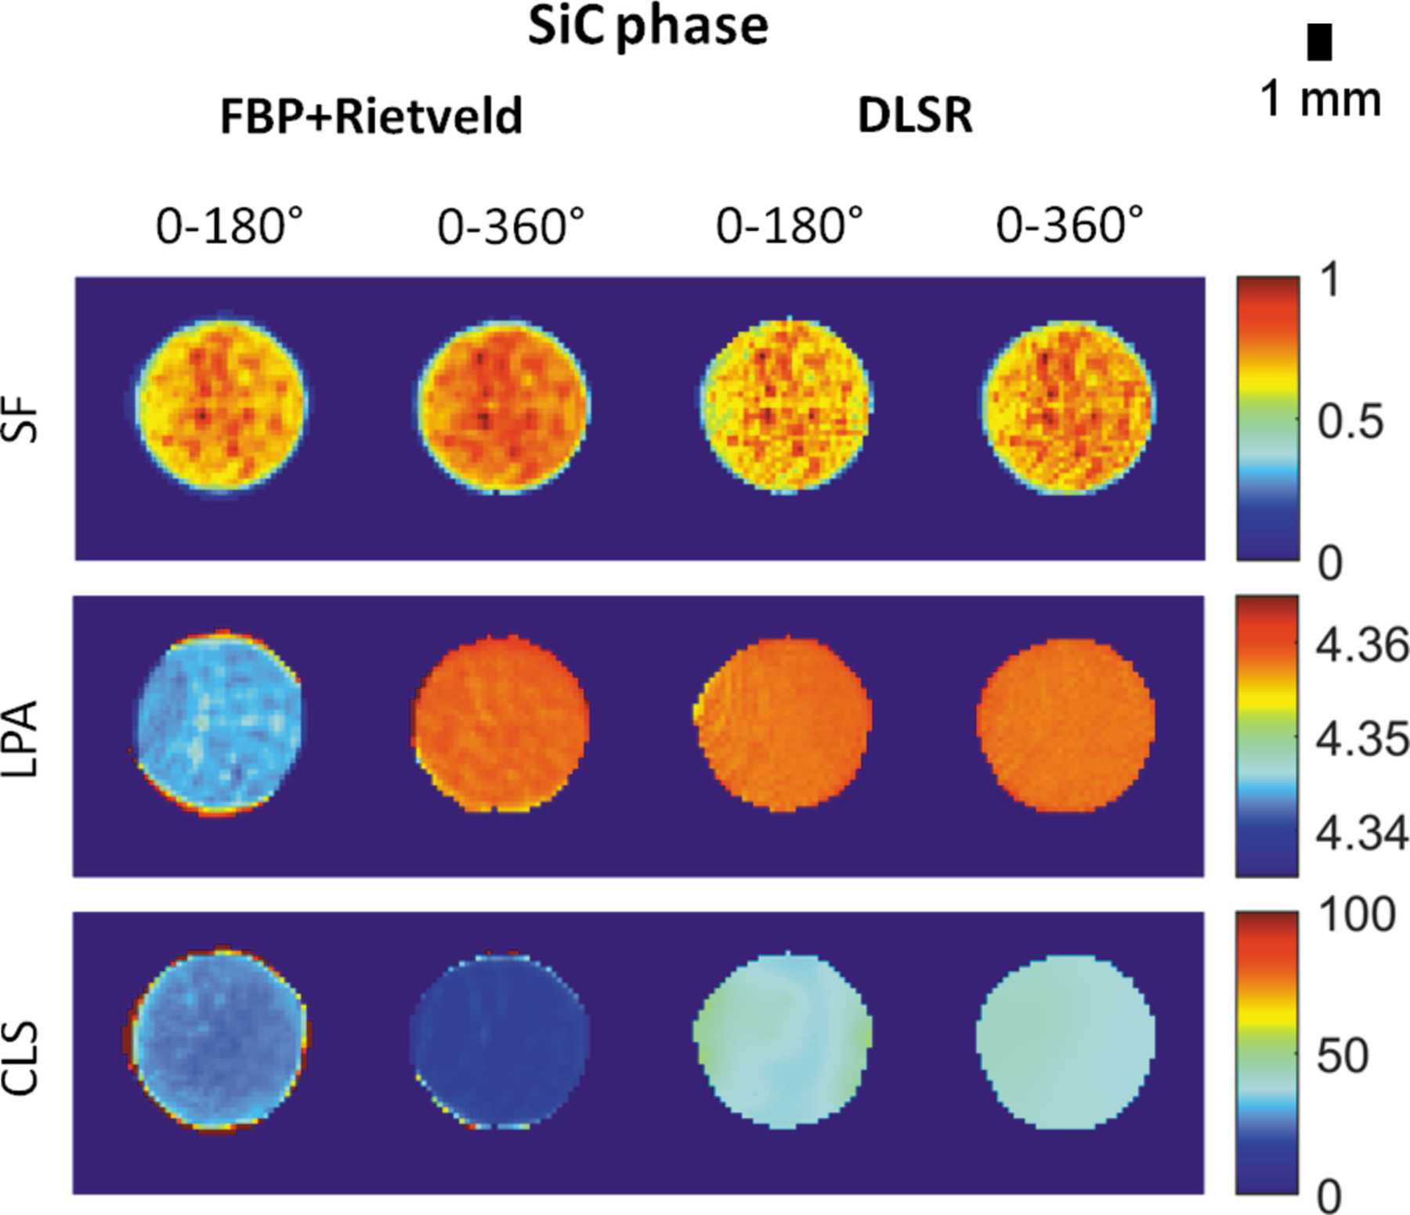
Figure 8. Top row: SiC normalized scale factor (SF) maps. Middle row: SiC lattice parameter a (LPA) maps (colour-bar axis in Å). Bottom row: SiC crystallite (CLS) maps (colour-bar axis in nm) ...
Vamvakeros et al.
Volume 53 | Part 6 | December 2020 | Pages 1531–1541 | 10.1107/S1600576720013576
Notes:
Top row: SiC normalized scale factor (SF) maps. Middle row: SiC lattice parameter a (LPA) maps (colour-bar axis in Å). Bottom row: SiC crystallite (CLS) maps (colour-bar axis in nm). [Vamvakeros, A., Coelho, A. A., Matras, D., Dong, H., Odarchenko, Y., Price, S. W. T., Butler, K. T., Gutowski, O., Dippel, A.-C., Zimmermann, M., Martens, I., Drnec, J., Beale, A. M., Jacques, S. D. M. and (2020). J. Appl. Cryst. 53, 1531-1541. 10.1107/S1600576720013576]

