Slide 1
(2E)-1-[5-Methyl-1-(4-methyl­phen­yl)-1H-1,2,3-triazol-4-yl]-3-[4-(piperidin-1-yl)phen­yl]prop-2-en-1-one
B. F. Abdel-Wahab, E. Abdel-Latif, S. W. Ng and E. R. T. Tiekink
Volume 69 | Part 5 | May 2013 | Pages o639–o640 | 10.1107/S1600536813008258
Notes:
Two independent mol­ecules comprise the asymmetric unit of the title compound, C24H26N4O. The major difference between them is found in the relative orientation of the triazole-bound p-tolyl group which have the opposite sense of twist [N—N—C—C torsion angles = 55.8 (3) and −49.8 (3)°]. The chalcone residue is almost coplanar with the triazole ring [N—C—C—O and C—C—C—C torsion angles = −178.9 (2) and −178.5 (2)°, respectively; cf. 177.9 (3) and 168.5 (3)°, respectively, in the second mol­ecule]. The conformation about each C═C double bond is E and in each case the triazole methyl group is syn to the carbonyl O atom. In the crystal, mol­ecules aggregate into layers parallel to (-113). The first independent mol­ecule self-associates into a layer via C—H···O and C—H···π inter­actions. By contrast, layers comprising the second independent mol­ecule do not feature specific inter­actions between mol­ecules. The global crystal packing comprises alternating layers.

Slide 2
(2E)-1-[5-Methyl-1-(4-methyl­phen­yl)-1H-1,2,3-triazol-4-yl]-3-[4-(piperidin-1-yl)phen­yl]prop-2-en-1-one
Two independent mol­ecules comprise the asymmetric unit of the title compound, C₂₄H₂₆N₄O. The major difference between them is found in the relative orientation of the triazole-bound p-tolyl group which have the opposite sense of twist [N—N—C—C torsion angles = 55.8 (3) and −49.8 (3)°]. The chalcone residue is almost coplanar with the triazole ring [N—C—C—O and C—C—C—C torsion angles = −178.9 (2) and −178.5 (2)°, respectively; cf. 177.9 (3) and 168.5 (3)°, respectively, in the second mol­ecule]. The conformation about each C═C double bond is E and in each case the triazole methyl group is syn to the carbonyl O atom. In the crystal, mol­ecules aggregate into layers parallel to (-113). The first independent mol­ecule self-associates into a layer via C—H···O and C—H···π inter­actions. By contrast, layers comprising the second independent mol­ecule do not feature specific inter­actions between mol­ecules. The global crystal packing comprises alternating layers.
Abdel-Wahab et al.
Volume 69 | Part 5 | May 2013 | Pages o639–o640 | 10.1107/S1600536813008258
Notes:
Two independent mol­ecules comprise the asymmetric unit of the title compound, C24H26N4O. The major difference between them is found in the relative orientation of the triazole-bound p-tolyl group which have the opposite sense of twist [N—N—C—C torsion angles = 55.8 (3) and −49.8 (3)°]. The chalcone residue is almost coplanar with the triazole ring [N—C—C—O and C—C—C—C torsion angles = −178.9 (2) and −178.5 (2)°, respectively; cf. 177.9 (3) and 168.5 (3)°, respectively, in the second mol­ecule]. The conformation about each C═C double bond is E and in each case the triazole methyl group is syn to the carbonyl O atom. In the crystal, mol­ecules aggregate into layers parallel to (-113). The first independent mol­ecule self-associates into a layer via C—H···O and C—H···π inter­actions. By contrast, layers comprising the second independent mol­ecule do not feature specific inter­actions between mol­ecules. The global crystal packing comprises alternating layers.

Slide 3
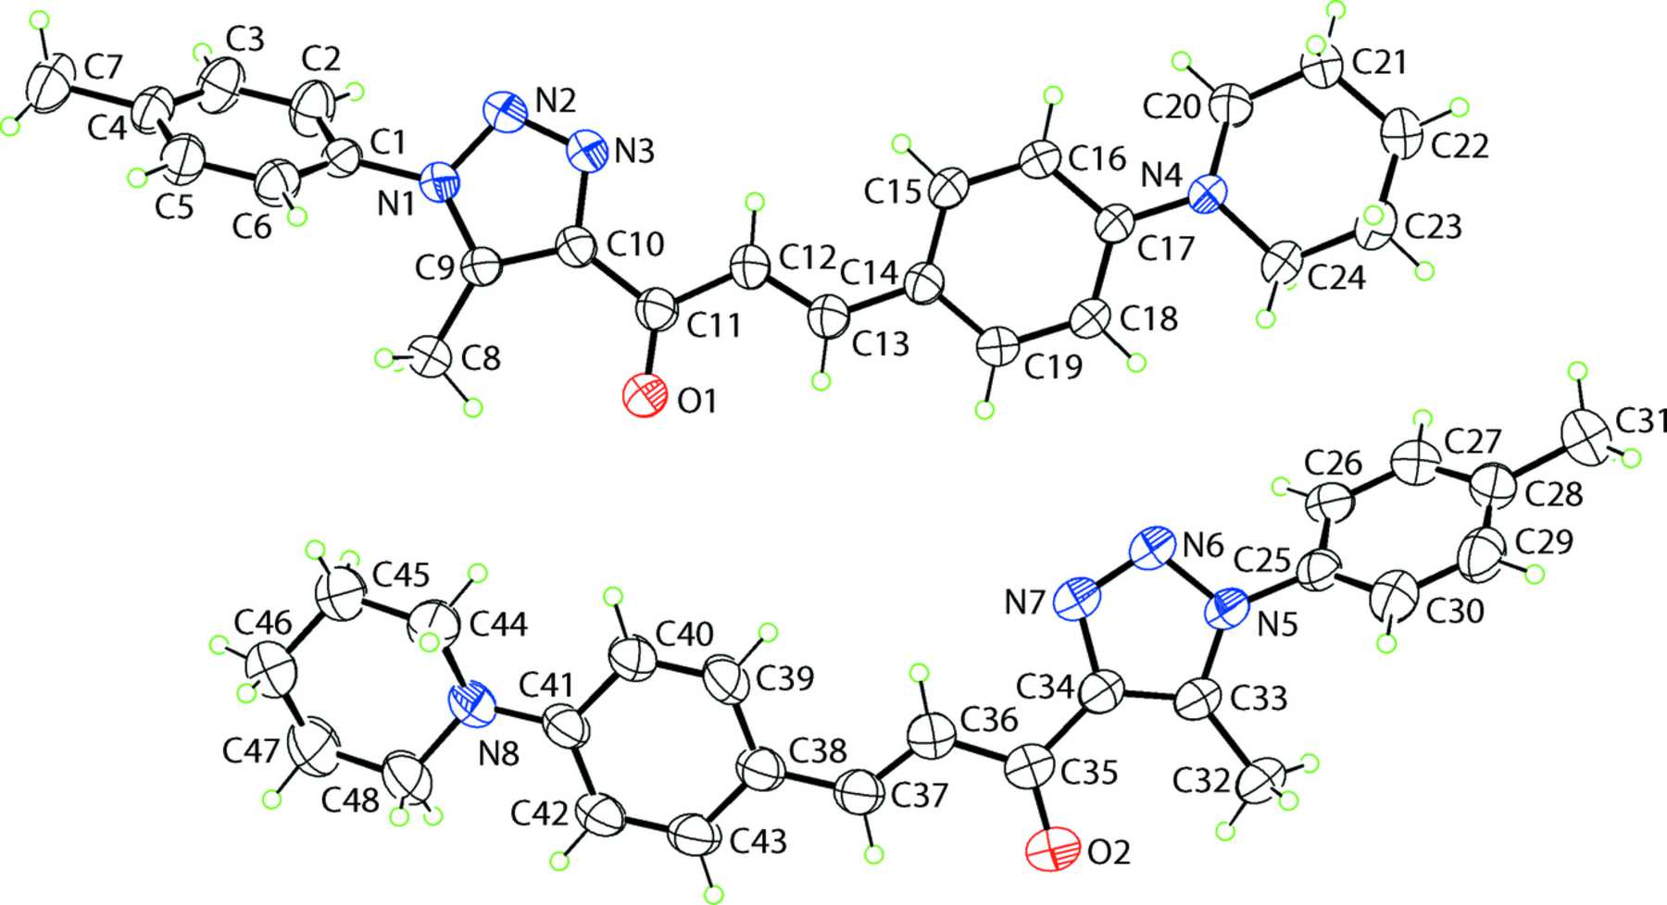
Figure 1. The mol­ecular structure of (I) showing displacement ellipsoids at the 35% probability level.
Abdel-Wahab et al.
Volume 69 | Part 5 | May 2013 | Pages o639–o640 | 10.1107/S1600536813008258
Notes:
The mol­ecular structure of (I) showing displacement ellipsoids at the 35% probability level. [Abdel-Wahab, B. F., Abdel-Latif, E., Ng, S. W. and Tiekink, E. R. T. (2013). Acta Cryst. E69, o639-o640. 10.1107/S1600536813008258]

Slide 4
Figure 2. Overlay diagram of the two independent mol­ecules comprising the asymmetric unit of (I). The O1- (red image) and O2-containing (blue) mol­ecules have been superimposed so that the five ...
Abdel-Wahab et al.
Volume 69 | Part 5 | May 2013 | Pages o639–o640 | 10.1107/S1600536813008258
Notes:
Overlay diagram of the two independent mol­ecules comprising the asymmetric unit of (I). The O1- (red image) and O2-containing (blue) mol­ecules have been superimposed so that the five-membered rings are coincident. [Abdel-Wahab, B. F., Abdel-Latif, E., Ng, S. W. and Tiekink, E. R. T. (2013). Acta Cryst. E69, o639-o640. 10.1107/S1600536813008258]

Slide 5
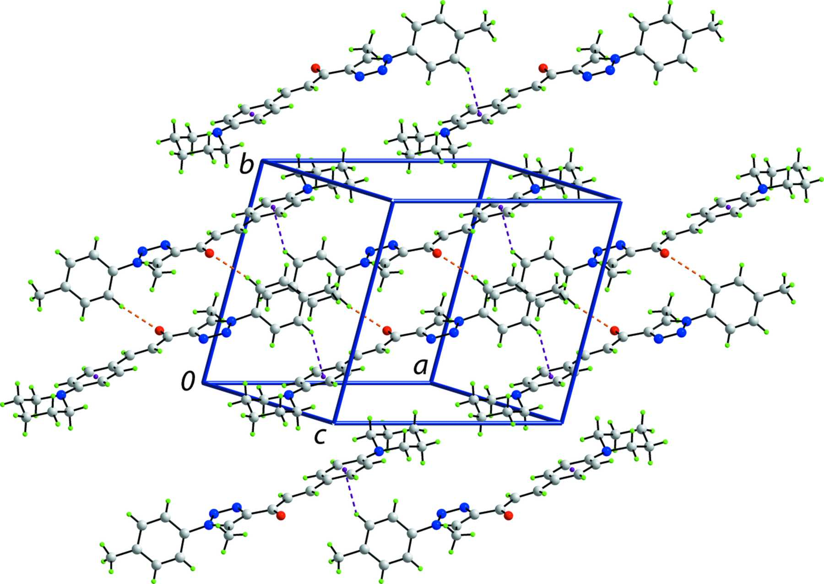
Figure 3. A view of the supra­molecular layer in (I) comprising O1-containing mol­ecules only, and sustained by C—H⋯O and C—H⋯π inter­actions, shown as orange ...
Abdel-Wahab et al.
Volume 69 | Part 5 | May 2013 | Pages o639–o640 | 10.1107/S1600536813008258
Notes:
A view of the supra­molecular layer in (I) comprising O1-containing mol­ecules only, and sustained by C—H⋯O and C—H⋯π inter­actions, shown as orange and purple dashed lines, respectively. [Abdel-Wahab, B. F., Abdel-Latif, E., Ng, S. W. and Tiekink, E. R. T. (2013). Acta Cryst. E69, o639-o640. 10.1107/S1600536813008258]

Slide 6
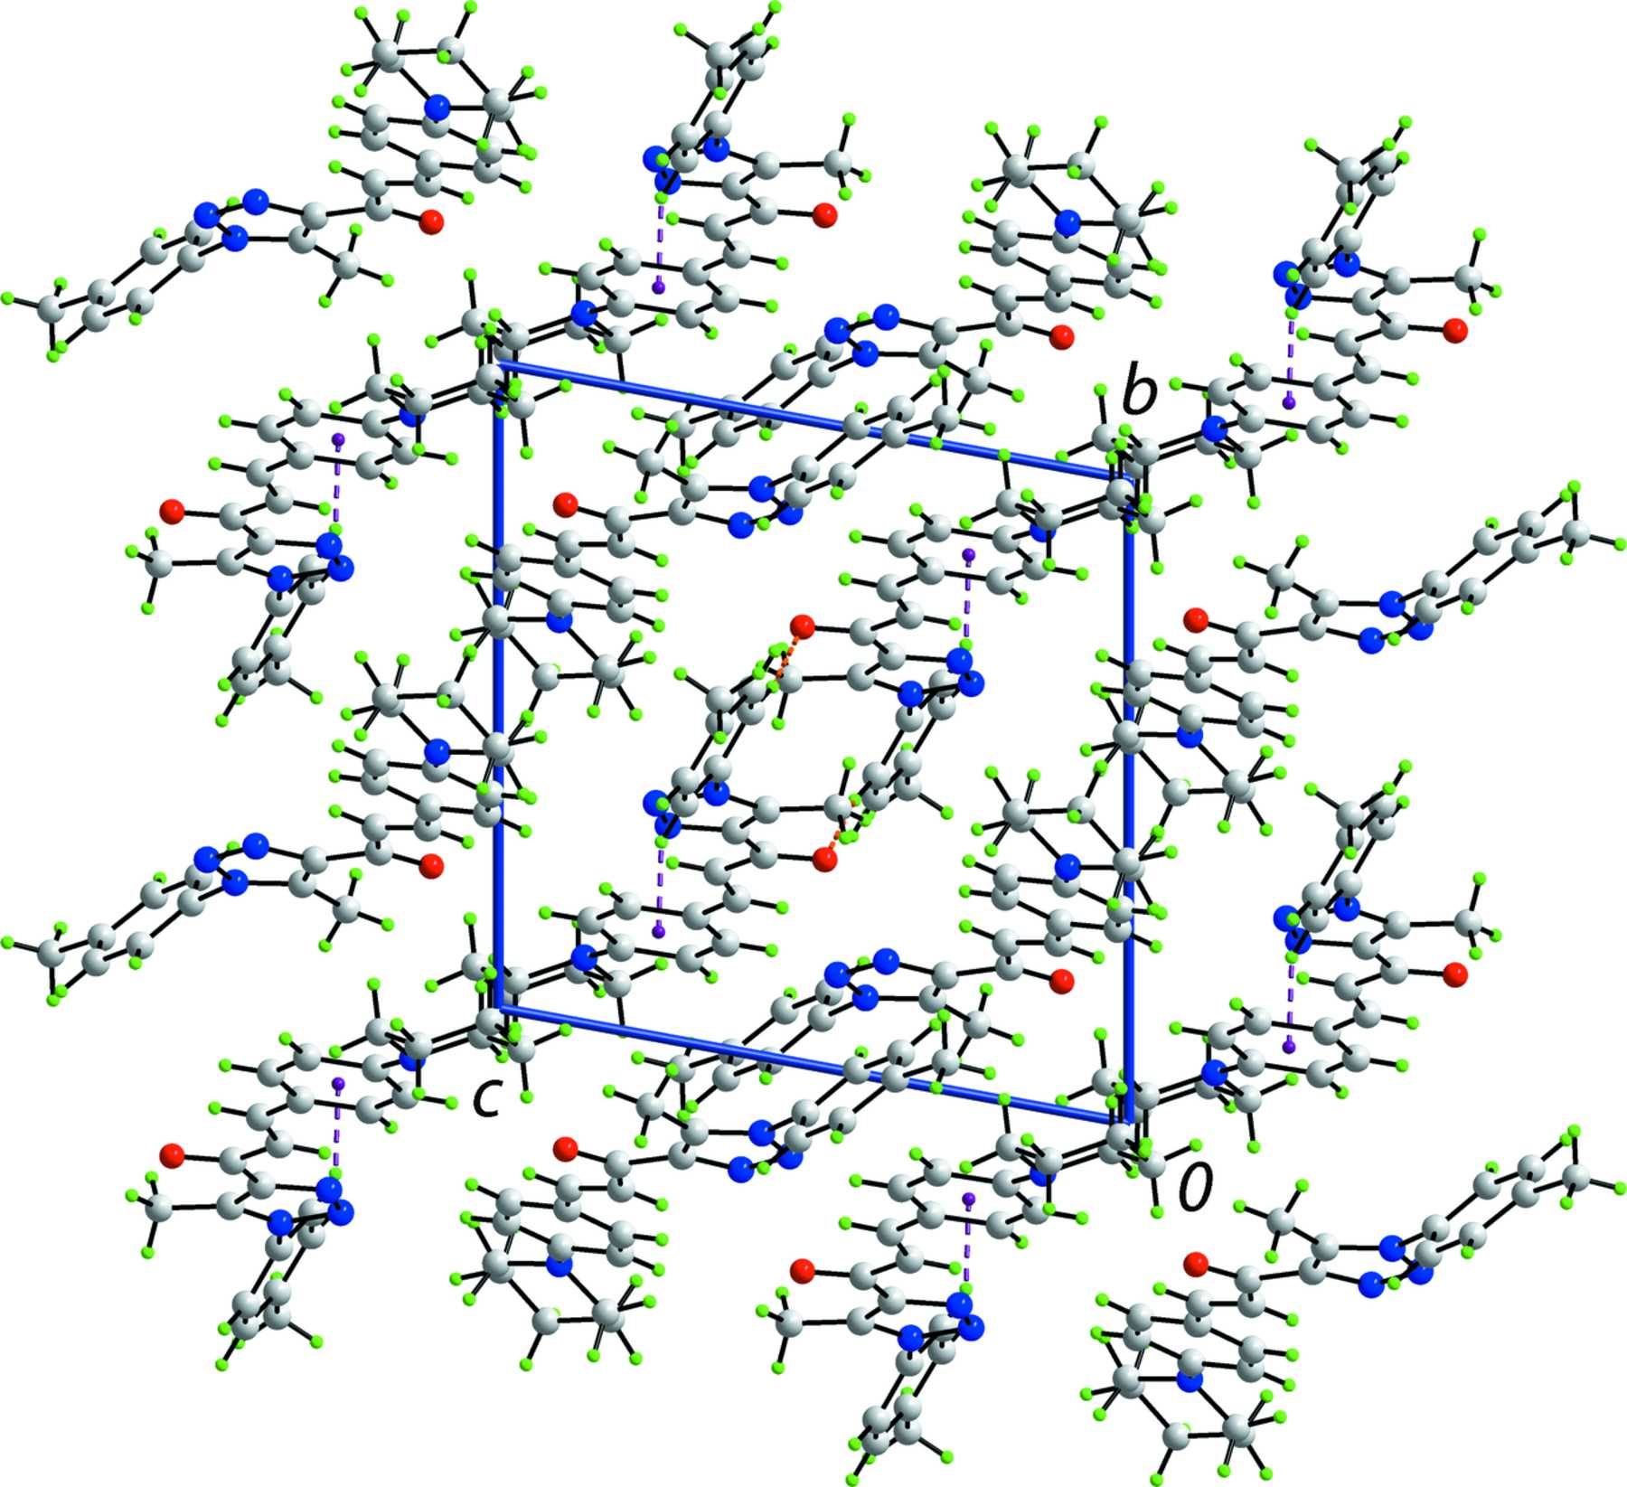
Figure 4. A view of the crystal packing in projection down the a axis, highlighting the alternating layers of O1- and O2-containing mol­ecules. The C—H⋯O and C—H⋯π ...
Abdel-Wahab et al.
Volume 69 | Part 5 | May 2013 | Pages o639–o640 | 10.1107/S1600536813008258
Notes:
A view of the crystal packing in projection down the a axis, highlighting the alternating layers of O1- and O2-containing mol­ecules. The C—H⋯O and C—H⋯π inter­actions are shown as orange and purple dashed lines, respectively. [Abdel-Wahab, B. F., Abdel-Latif, E., Ng, S. W. and Tiekink, E. R. T. (2013). Acta Cryst. E69, o639-o640. 10.1107/S1600536813008258]

