Slide 1
Bent crystal Laue analyser combined with total reflection fluorescence X-ray absorption fine structure (BCLA + TRF-XAFS) and its application to surface studies
Y. Wakisaka, B. Hu, D. Kido, M. H. Al Rashid, W. Chen, K. Dong, T. Wada, B. Bharate, Q. Yuan, S. Mukai, Y. Takeichi, S. Takakusagi and K. Asakura
Volume 27 | Part 6 | Novemeber 2020 | Pages 1618–1625 | 10.1107/S1600577520011170
Notes:
A bent crystal Laue analyser combined with total reflection fluorescence X-ray absorption fine structure is a promising technique for in situ surface analysis of highly dispersed systems even in the presence of solution.

Slide 2
Bent crystal Laue analyser combined with total reflection fluorescence X-ray absorption fine structure (BCLA + TRF-XAFS) and its application to surface studies
A bent crystal Laue analyser combined with total reflection fluorescence X-ray absorption fine structure is a promising technique for in situ surface analysis of highly dispersed systems even in the presence of solution.
Keywords: X-ray absorption fine structure; bent crystal Laue analyser; total reflection fluorescence X-ray absorption fine structure; in situ surface X-ray absorption fine structure
Wakisaka et al.
Volume 27 | Part 6 | Novemeber 2020 | Pages 1618–1625 | 10.1107/S1600577520011170
Notes:
A bent crystal Laue analyser (BCLA) is an X-ray energy analyser used for fluorescence X-ray absorption fine-structure (XAFS) spectroscopy to separate the fluorescence X-ray emission line of a target atom from the elastic scattering X-rays and other fluorescence emission lines. Here, the feasibility of the BCLA for total reflection fluorescence XAFS (TRF-XAFS), which has a long X-ray footprint on the substrate surface owing to grazing incidence, was tested. The focal line of the BCLA was adjusted on the X-ray footprint and the XAFS signal for one monolayer of Pt deposited on a 60 nm Au film with high sensitivity was obtained. Although range-extended XAFS was expected by the rejection of Au fluorescence arising from the Au substrate, a small glitch was found in the Au L3 edge because of the sudden change of the complex refraction index of the Au substrate at the Au edge. This abnormal spectrum feature can be removed by reflectivity correction using Au foil absorption data. BCLA combined with TRF-XAFS spectroscopy (BCLA + TRF-XAFS) is a new technique for the in situ surface analysis of highly dispersed systems even in the presence of a liquid overlayer.

Slide 3
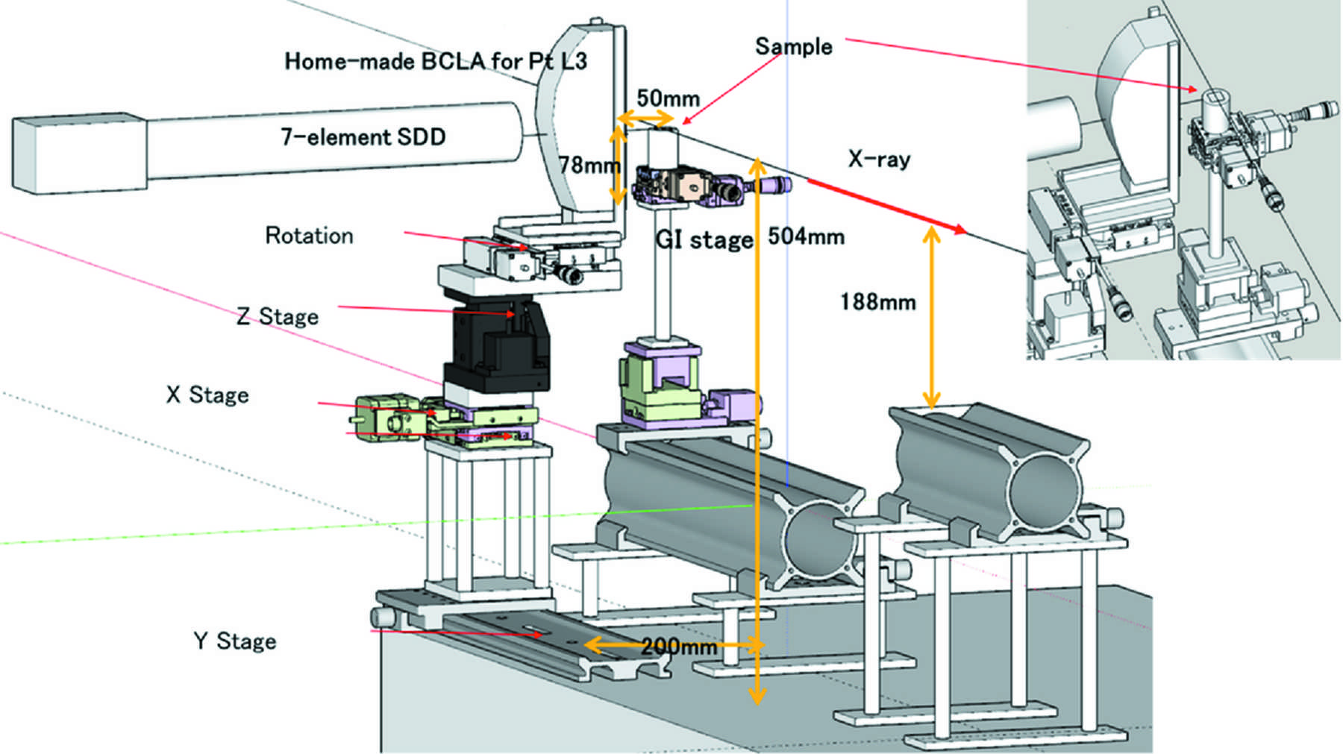
Figure 1. Schematic of the TRF-XAFS system. The incident X-rays come from the left side and the fluorescent X-rays are analysed by BCLA. The BCLA is covered with a lead sheet, except for its entrance and ...
Wakisaka et al.
Volume 27 | Part 6 | Novemeber 2020 | Pages 1618–1625 | 10.1107/S1600577520011170
Notes:
Schematic of the TRF-XAFS system. The incident X-rays come from the left side and the fluorescent X-rays are analysed by BCLA. The BCLA is covered with a lead sheet, except for its entrance and exit windows. [Wakisaka, Y., Hu, B., Kido, D., Al Rashid, M. H., Chen, W., Dong, K., Wada, T., Bharate, B., Yuan, Q., Mukai, S., Takeichi, Y., Takakusagi, S. and Asakura, K. (2020). J. Synchrotron Rad. 27, 1618-1625. 10.1107/S1600577520011170]

Slide 4
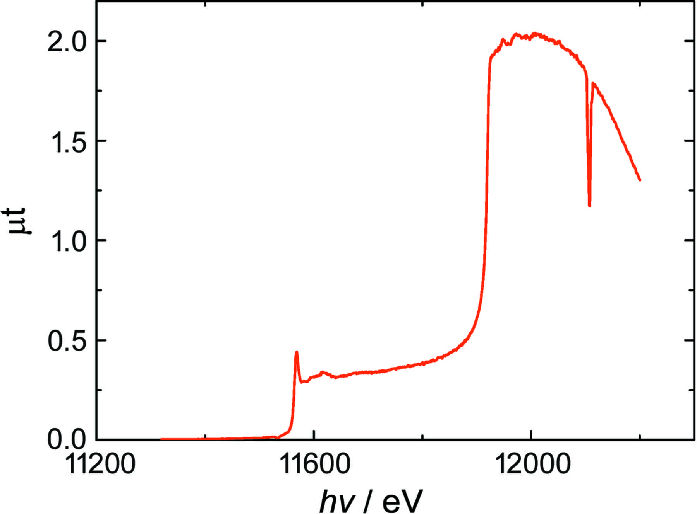
Figure 2. TRF-XAFS spectrum of Pt/Au/Si measured by SDD without the BCLA. The SDD energy window was set in the range 9.1–9.5 keV.
Wakisaka et al.
Volume 27 | Part 6 | Novemeber 2020 | Pages 1618–1625 | 10.1107/S1600577520011170
Notes:
TRF-XAFS spectrum of Pt/Au/Si measured by SDD without the BCLA. The SDD energy window was set in the range 9.1–9.5 keV. [Wakisaka, Y., Hu, B., Kido, D., Al Rashid, M. H., Chen, W., Dong, K., Wada, T., Bharate, B., Yuan, Q., Mukai, S., Takeichi, Y., Takakusagi, S. and Asakura, K. (2020). J. Synchrotron Rad. 27, 1618-1625. 10.1107/S1600577520011170]

Slide 5
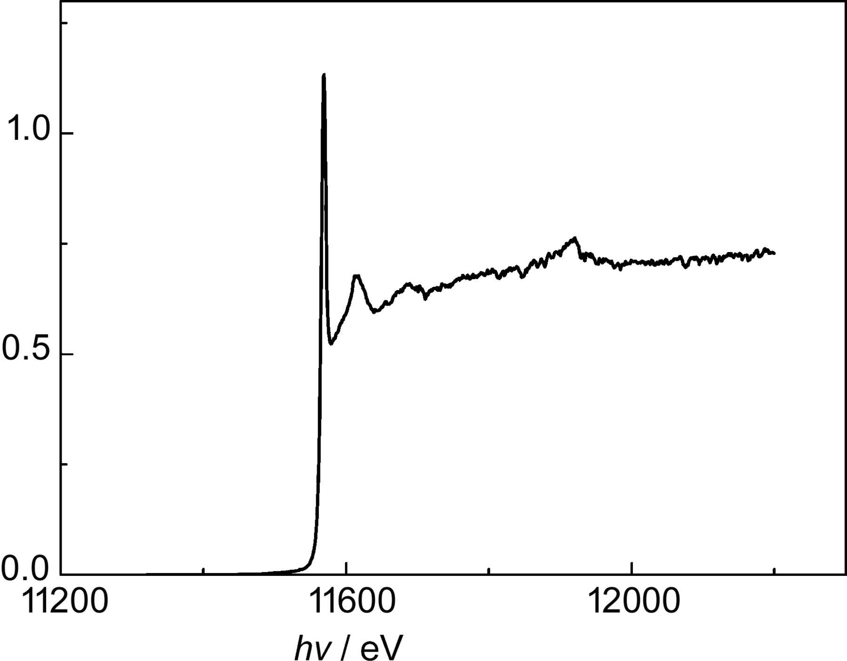
Figure 3. TRF-XAFS spectrum of Pt/Au/Si measured with the BCLA and SDD.
Wakisaka et al.
Volume 27 | Part 6 | Novemeber 2020 | Pages 1618–1625 | 10.1107/S1600577520011170
Notes:
TRF-XAFS spectrum of Pt/Au/Si measured with the BCLA and SDD. [Wakisaka, Y., Hu, B., Kido, D., Al Rashid, M. H., Chen, W., Dong, K., Wada, T., Bharate, B., Yuan, Q., Mukai, S., Takeichi, Y., Takakusagi, S. and Asakura, K. (2020). J. Synchrotron Rad. 27, 1618-1625. 10.1107/S1600577520011170]

Slide 6
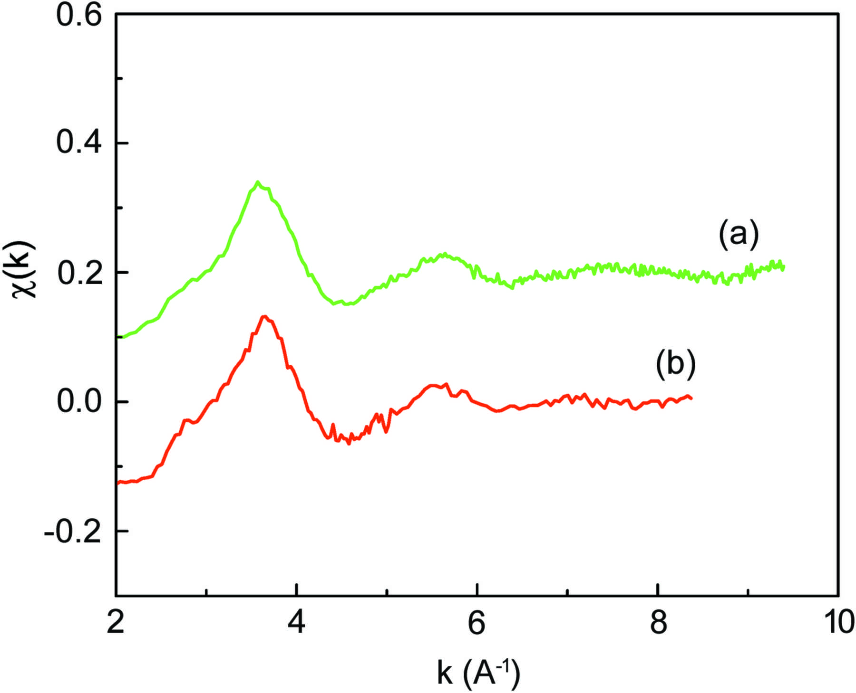
Figure 4. XAFS oscillations [χ(k)] for Pt/Au/Si (a) with and (b) without BCLA.
Wakisaka et al.
Volume 27 | Part 6 | Novemeber 2020 | Pages 1618–1625 | 10.1107/S1600577520011170
Notes:
XAFS oscillations [χ(k)] for Pt/Au/Si (a) with and (b) without BCLA. [Wakisaka, Y., Hu, B., Kido, D., Al Rashid, M. H., Chen, W., Dong, K., Wada, T., Bharate, B., Yuan, Q., Mukai, S., Takeichi, Y., Takakusagi, S. and Asakura, K. (2020). J. Synchrotron Rad. 27, 1618-1625. 10.1107/S1600577520011170]

Slide 7
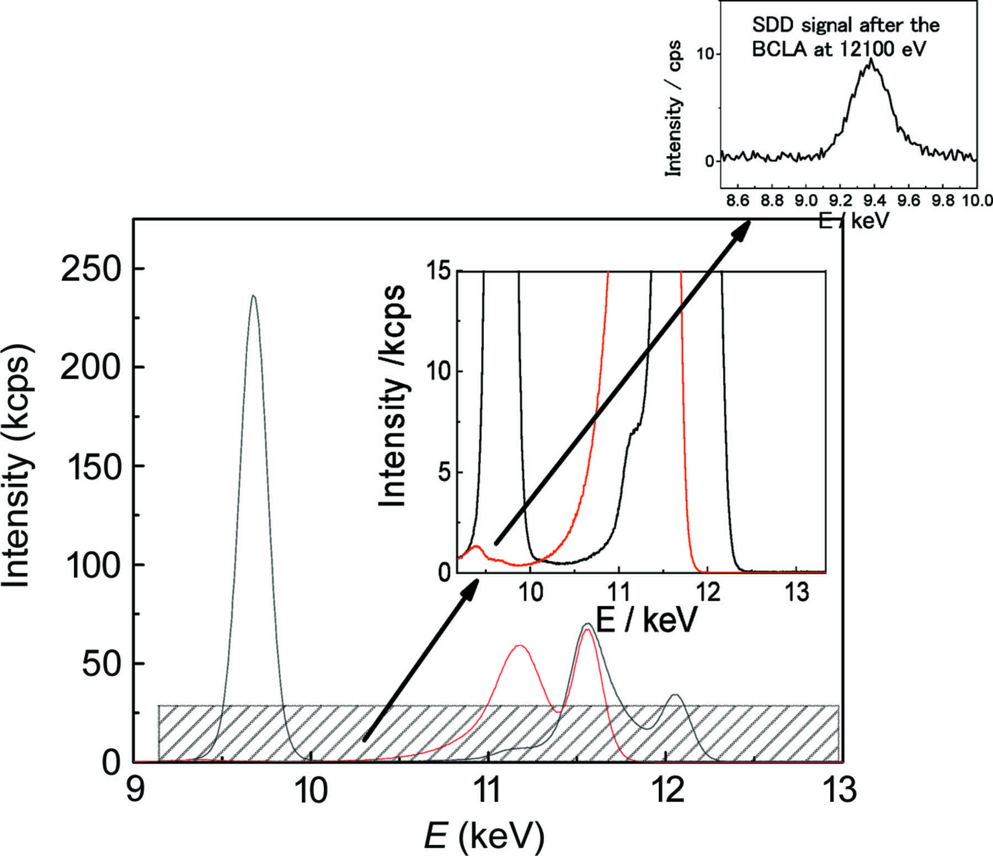
Figure 5. Spectra of X-rays detected by SDD. The red and black curves correspond to the incident X-ray energy before (11300 eV) and after (12100 eV) the Au edge, respectively; the peaks at 9442 eV ...
Wakisaka et al.
Volume 27 | Part 6 | Novemeber 2020 | Pages 1618–1625 | 10.1107/S1600577520011170
Notes:
Spectra of X-rays detected by SDD. The red and black curves correspond to the incident X-ray energy before (11300 eV) and after (12100 eV) the Au edge, respectively; the peaks at 9442 eV and 9628 eV correspond to Pt and Au Lα, respectively. [Wakisaka, Y., Hu, B., Kido, D., Al Rashid, M. H., Chen, W., Dong, K., Wada, T., Bharate, B., Yuan, Q., Mukai, S., Takeichi, Y., Takakusagi, S. and Asakura, K. (2020). J. Synchrotron Rad. 27, 1618-1625. 10.1107/S1600577520011170]

Slide 8
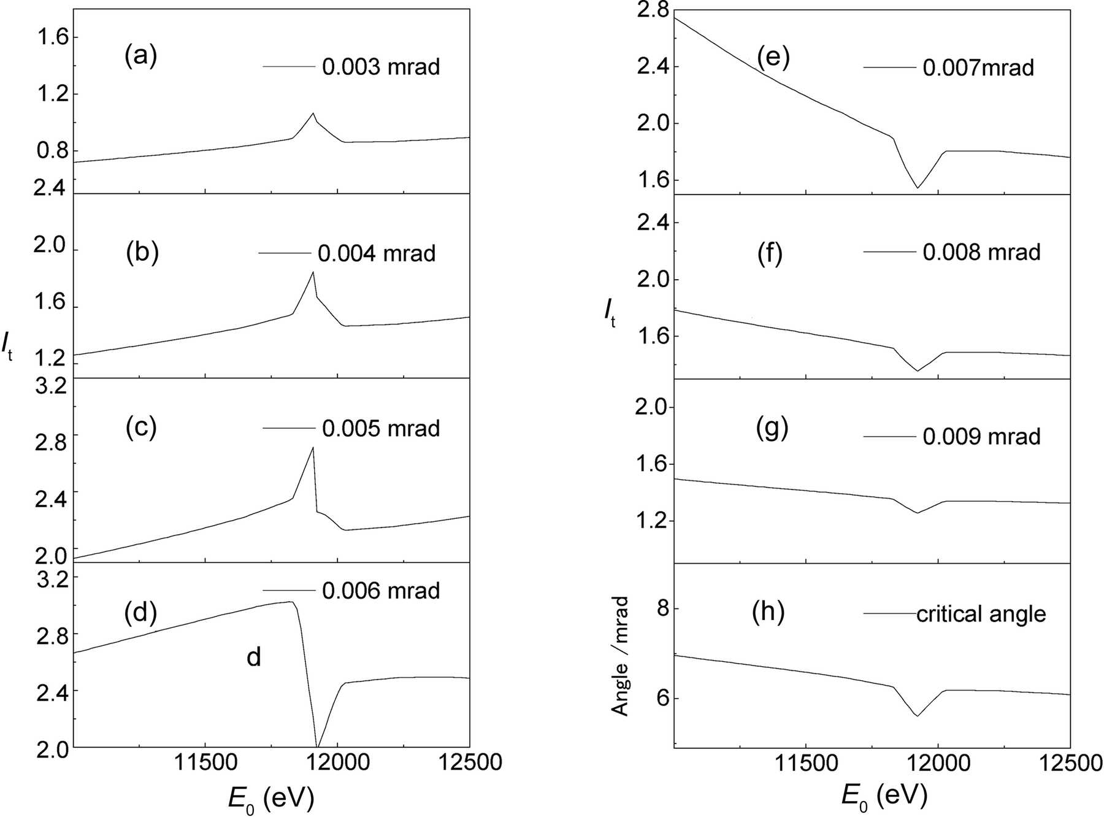
Figure 6. (a) Photon energy dependence of the total excitation X-ray intensity (I_{t}) with various critical angles (a)–(g) calculated based on the atomic scattering ...
Wakisaka et al.
Volume 27 | Part 6 | Novemeber 2020 | Pages 1618–1625 | 10.1107/S1600577520011170
Notes:
(a) Photon energy dependence of the total excitation X-ray intensity (It) with various critical angles (a)–(g) calculated based on the atomic scattering factors (Gullikson, 2001; Henke et al., 1993; Nelson et al., 1994). (h) Photon energy dependence of the critical angle. [Wakisaka, Y., Hu, B., Kido, D., Al Rashid, M. H., Chen, W., Dong, K., Wada, T., Bharate, B., Yuan, Q., Mukai, S., Takeichi, Y., Takakusagi, S. and Asakura, K. (2020). J. Synchrotron Rad. 27, 1618-1625. 10.1107/S1600577520011170]

Slide 9
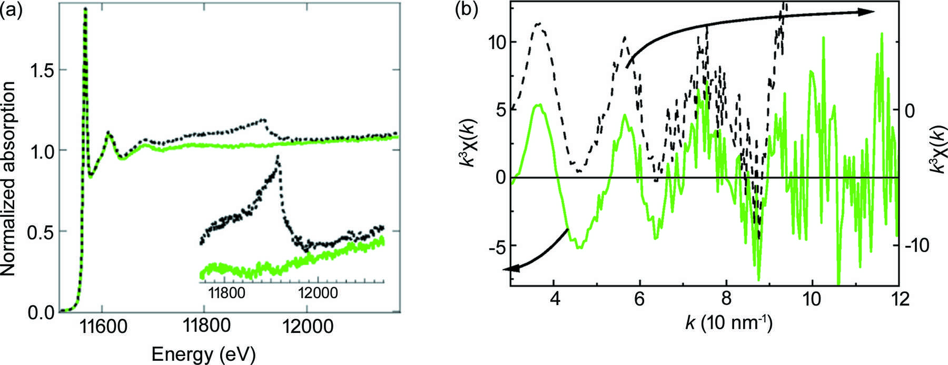
Figure 7. XAFS spectrum after absorption correction based on the experimental absorption data of (a) Au foil and (b) k³χ(k) (black-broken and green-solid lines are ...
Wakisaka et al.
Volume 27 | Part 6 | Novemeber 2020 | Pages 1618–1625 | 10.1107/S1600577520011170
Notes:
XAFS spectrum after absorption correction based on the experimental absorption data of (a) Au foil and (b) k3χ(k) (black-broken and green-solid lines are for uncorrected and corrected spectra, respectively). [Wakisaka, Y., Hu, B., Kido, D., Al Rashid, M. H., Chen, W., Dong, K., Wada, T., Bharate, B., Yuan, Q., Mukai, S., Takeichi, Y., Takakusagi, S. and Asakura, K. (2020). J. Synchrotron Rad. 27, 1618-1625. 10.1107/S1600577520011170]

Slide 10
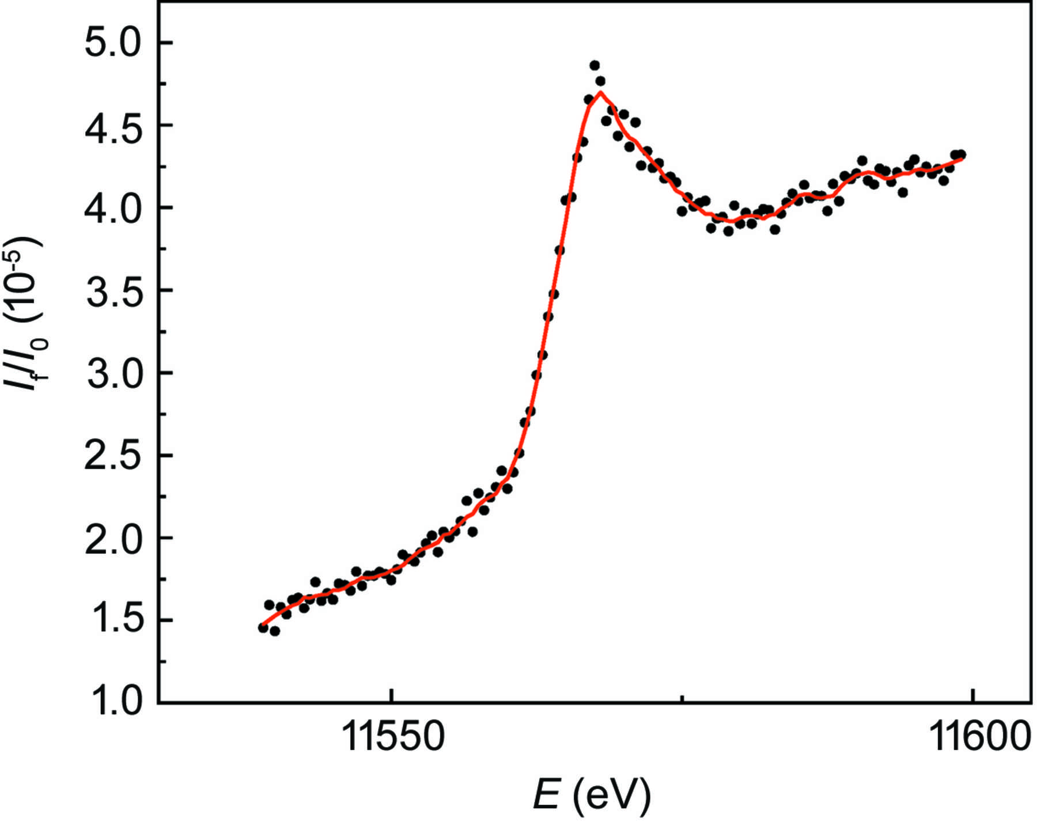
Figure 8. XANES spectra of 0.1 ML Pt on Au under −0.16 V_{Ag/AgCl} potential. The electrolyte was 0.1 ML HClO₄ and the accumulation time was 100 s per point.
Wakisaka et al.
Volume 27 | Part 6 | Novemeber 2020 | Pages 1618–1625 | 10.1107/S1600577520011170
Notes:
XANES spectra of 0.1 ML Pt on Au under −0.16 VAg/AgCl potential. The electrolyte was 0.1 ML HClO4 and the accumulation time was 100 s per point. [Wakisaka, Y., Hu, B., Kido, D., Al Rashid, M. H., Chen, W., Dong, K., Wada, T., Bharate, B., Yuan, Q., Mukai, S., Takeichi, Y., Takakusagi, S. and Asakura, K. (2020). J. Synchrotron Rad. 27, 1618-1625. 10.1107/S1600577520011170]

